Slide 1
ABCUSA Clergy and Congregations Theology, Ideology, and Demography
Dr. Ryan Burge
Eastern Illinois University

Slide 2
Survey Background
Sent an email invitation to as many ABC pastors we could find
Conducted from October 25th – November 7th, 2016
In total, received a full survey response from 168 clergy

Slide 3
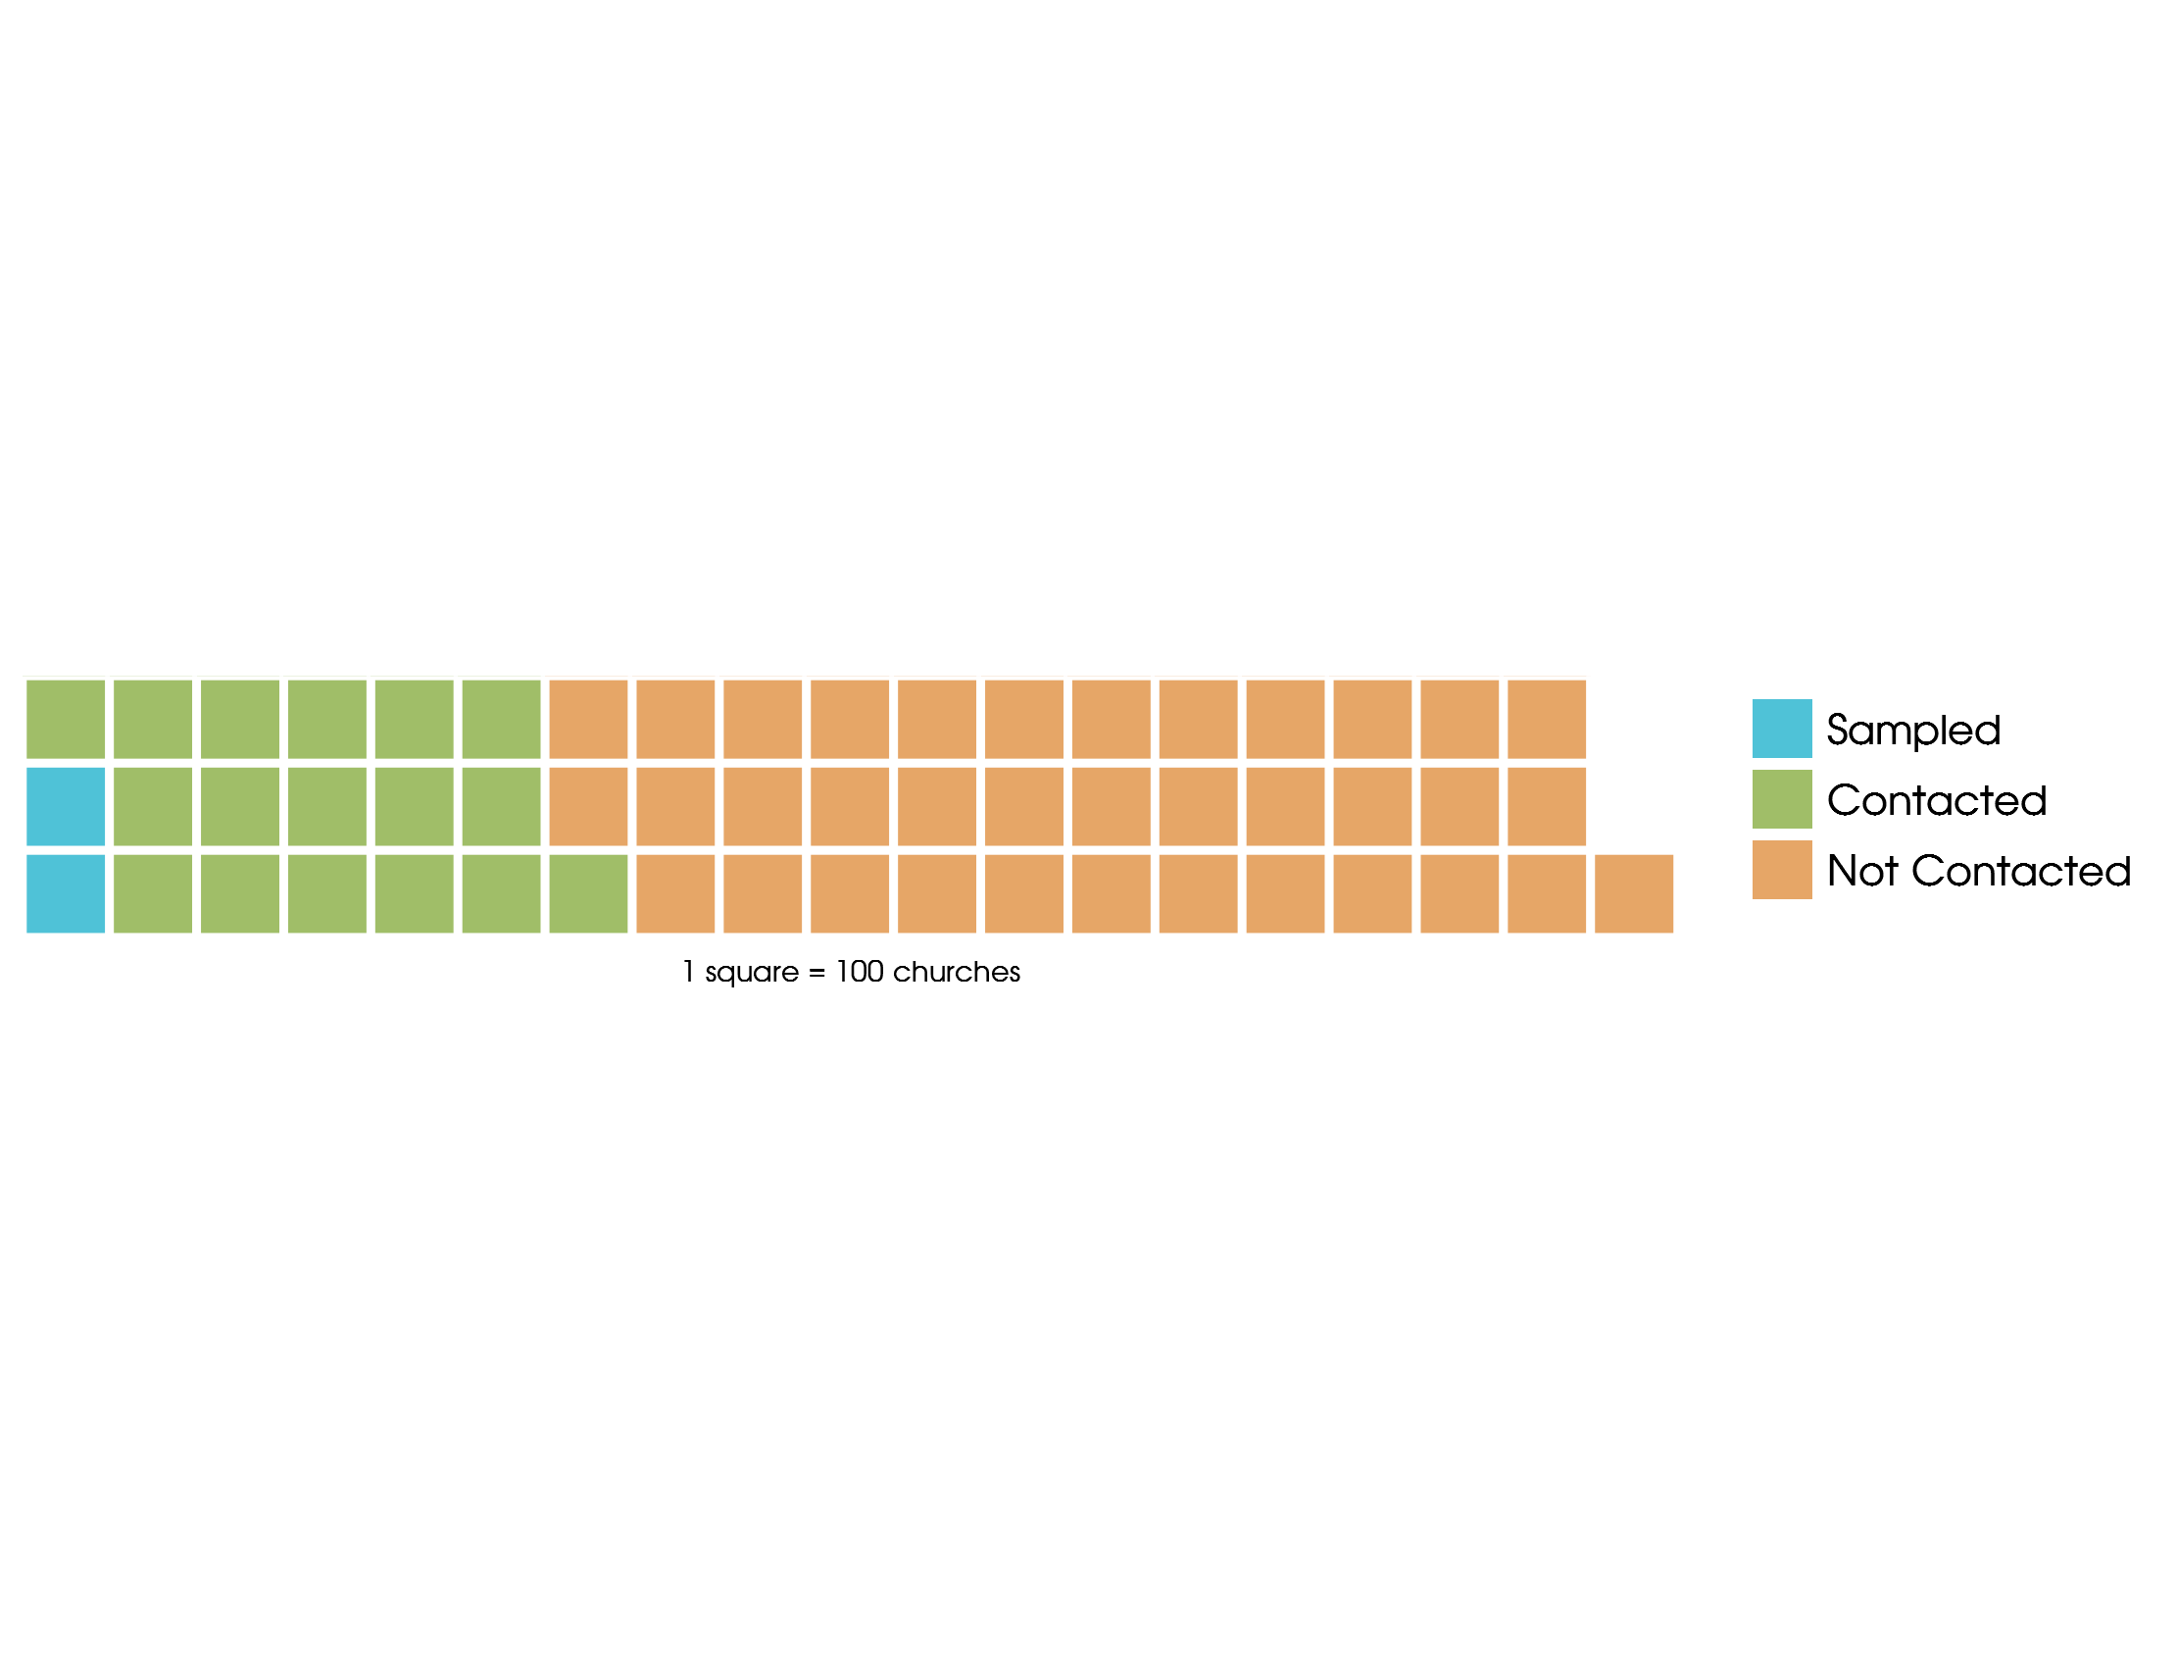
Notes:
Not much external validity. Having a more representative sample would help.

Slide 4
Two Additional Data Sources
Cooperative Clergy Study
Surveys clergy in several established denominations
Greek Orthodox, PCUSA, RCA, SBC, UMC
Provides a good reference group for ABC clergy
Cooperative Congressional Election Study
Large survey of American voters
2016 Survey had 64,600 Respondents
608 ABCUSA self-identified adherents
How are ABC clergy different than ABC laity?

Slide 5
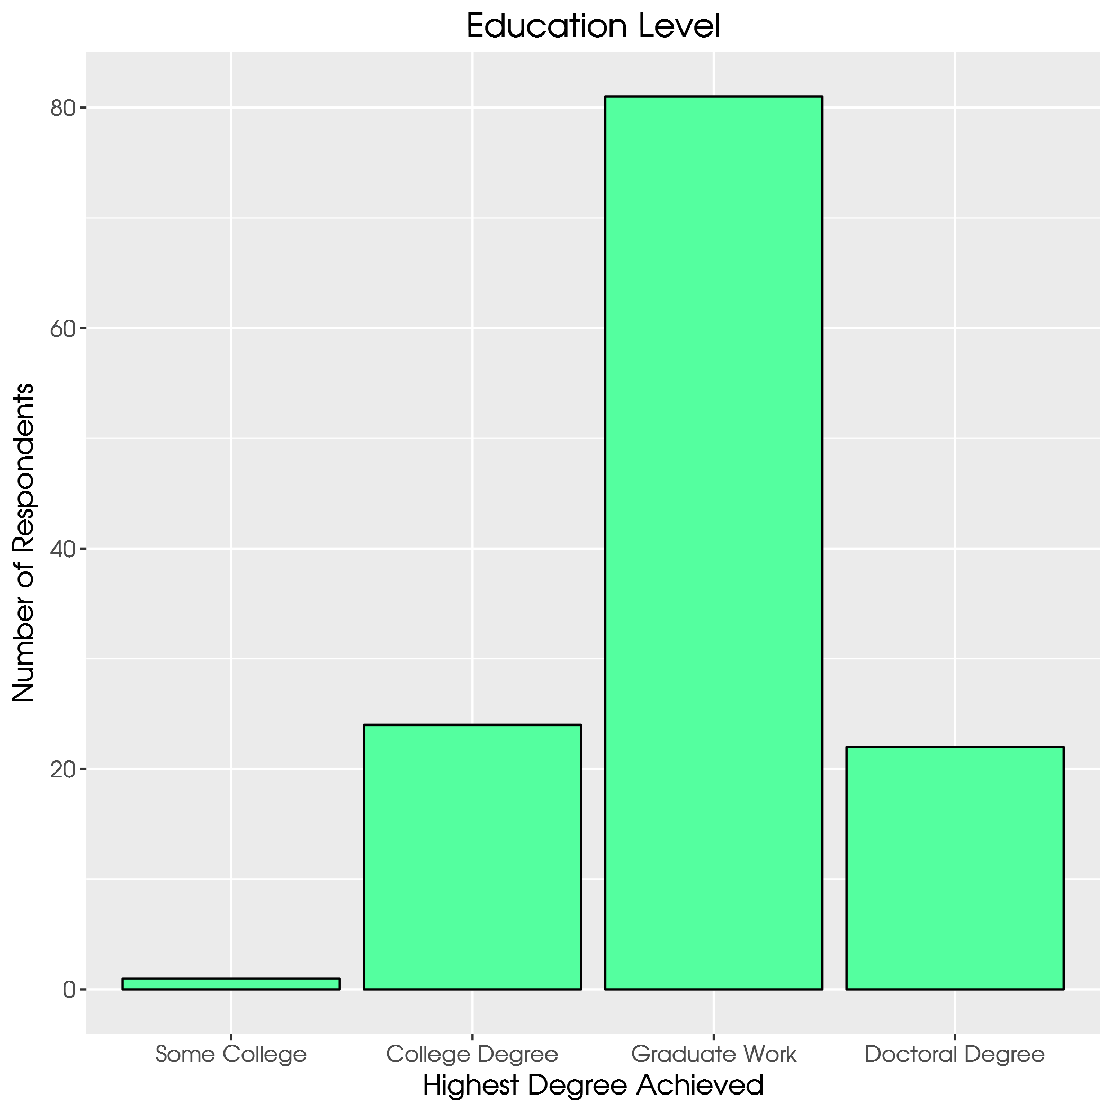
Notes:
This seems tilted strongly toward educated pastors. Bi-vocational. Graduate work in what?

Slide 6
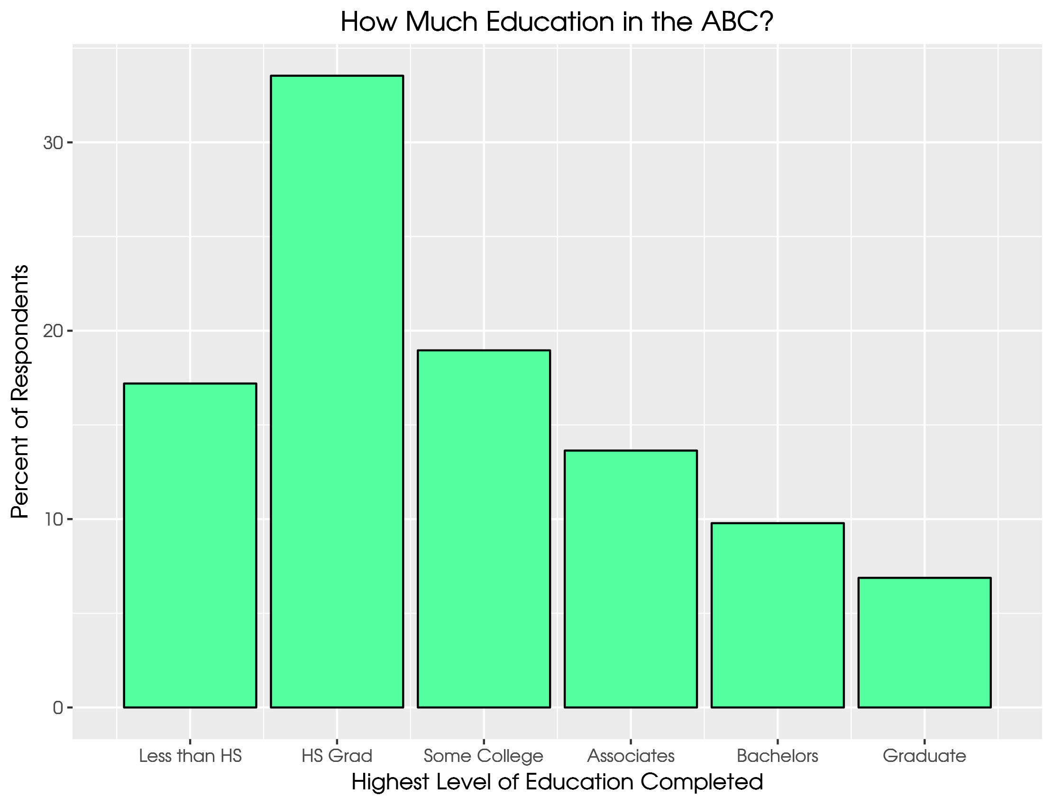
Notes:
Over half of the laity in the sample had HS diploma at most

Slide 7
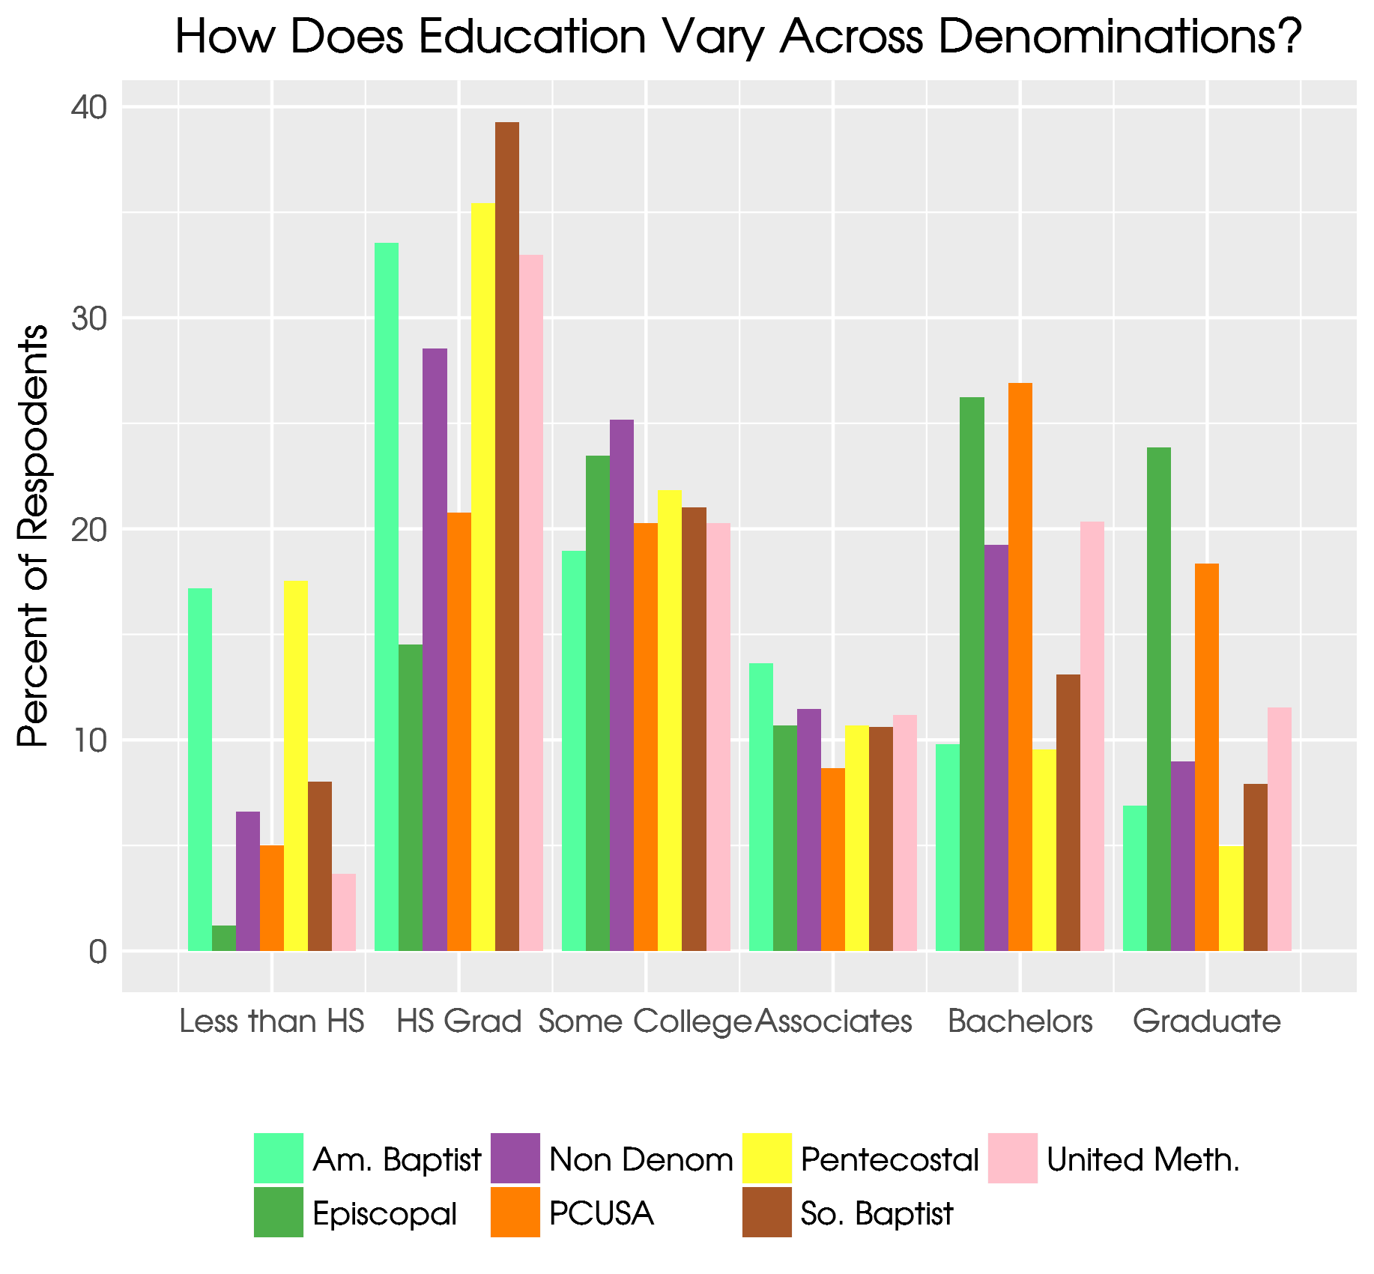
Notes:
Compare ABCUSA to other ML denoms like Episcopal. Then compare to SBC or Pentecostal.

Slide 8
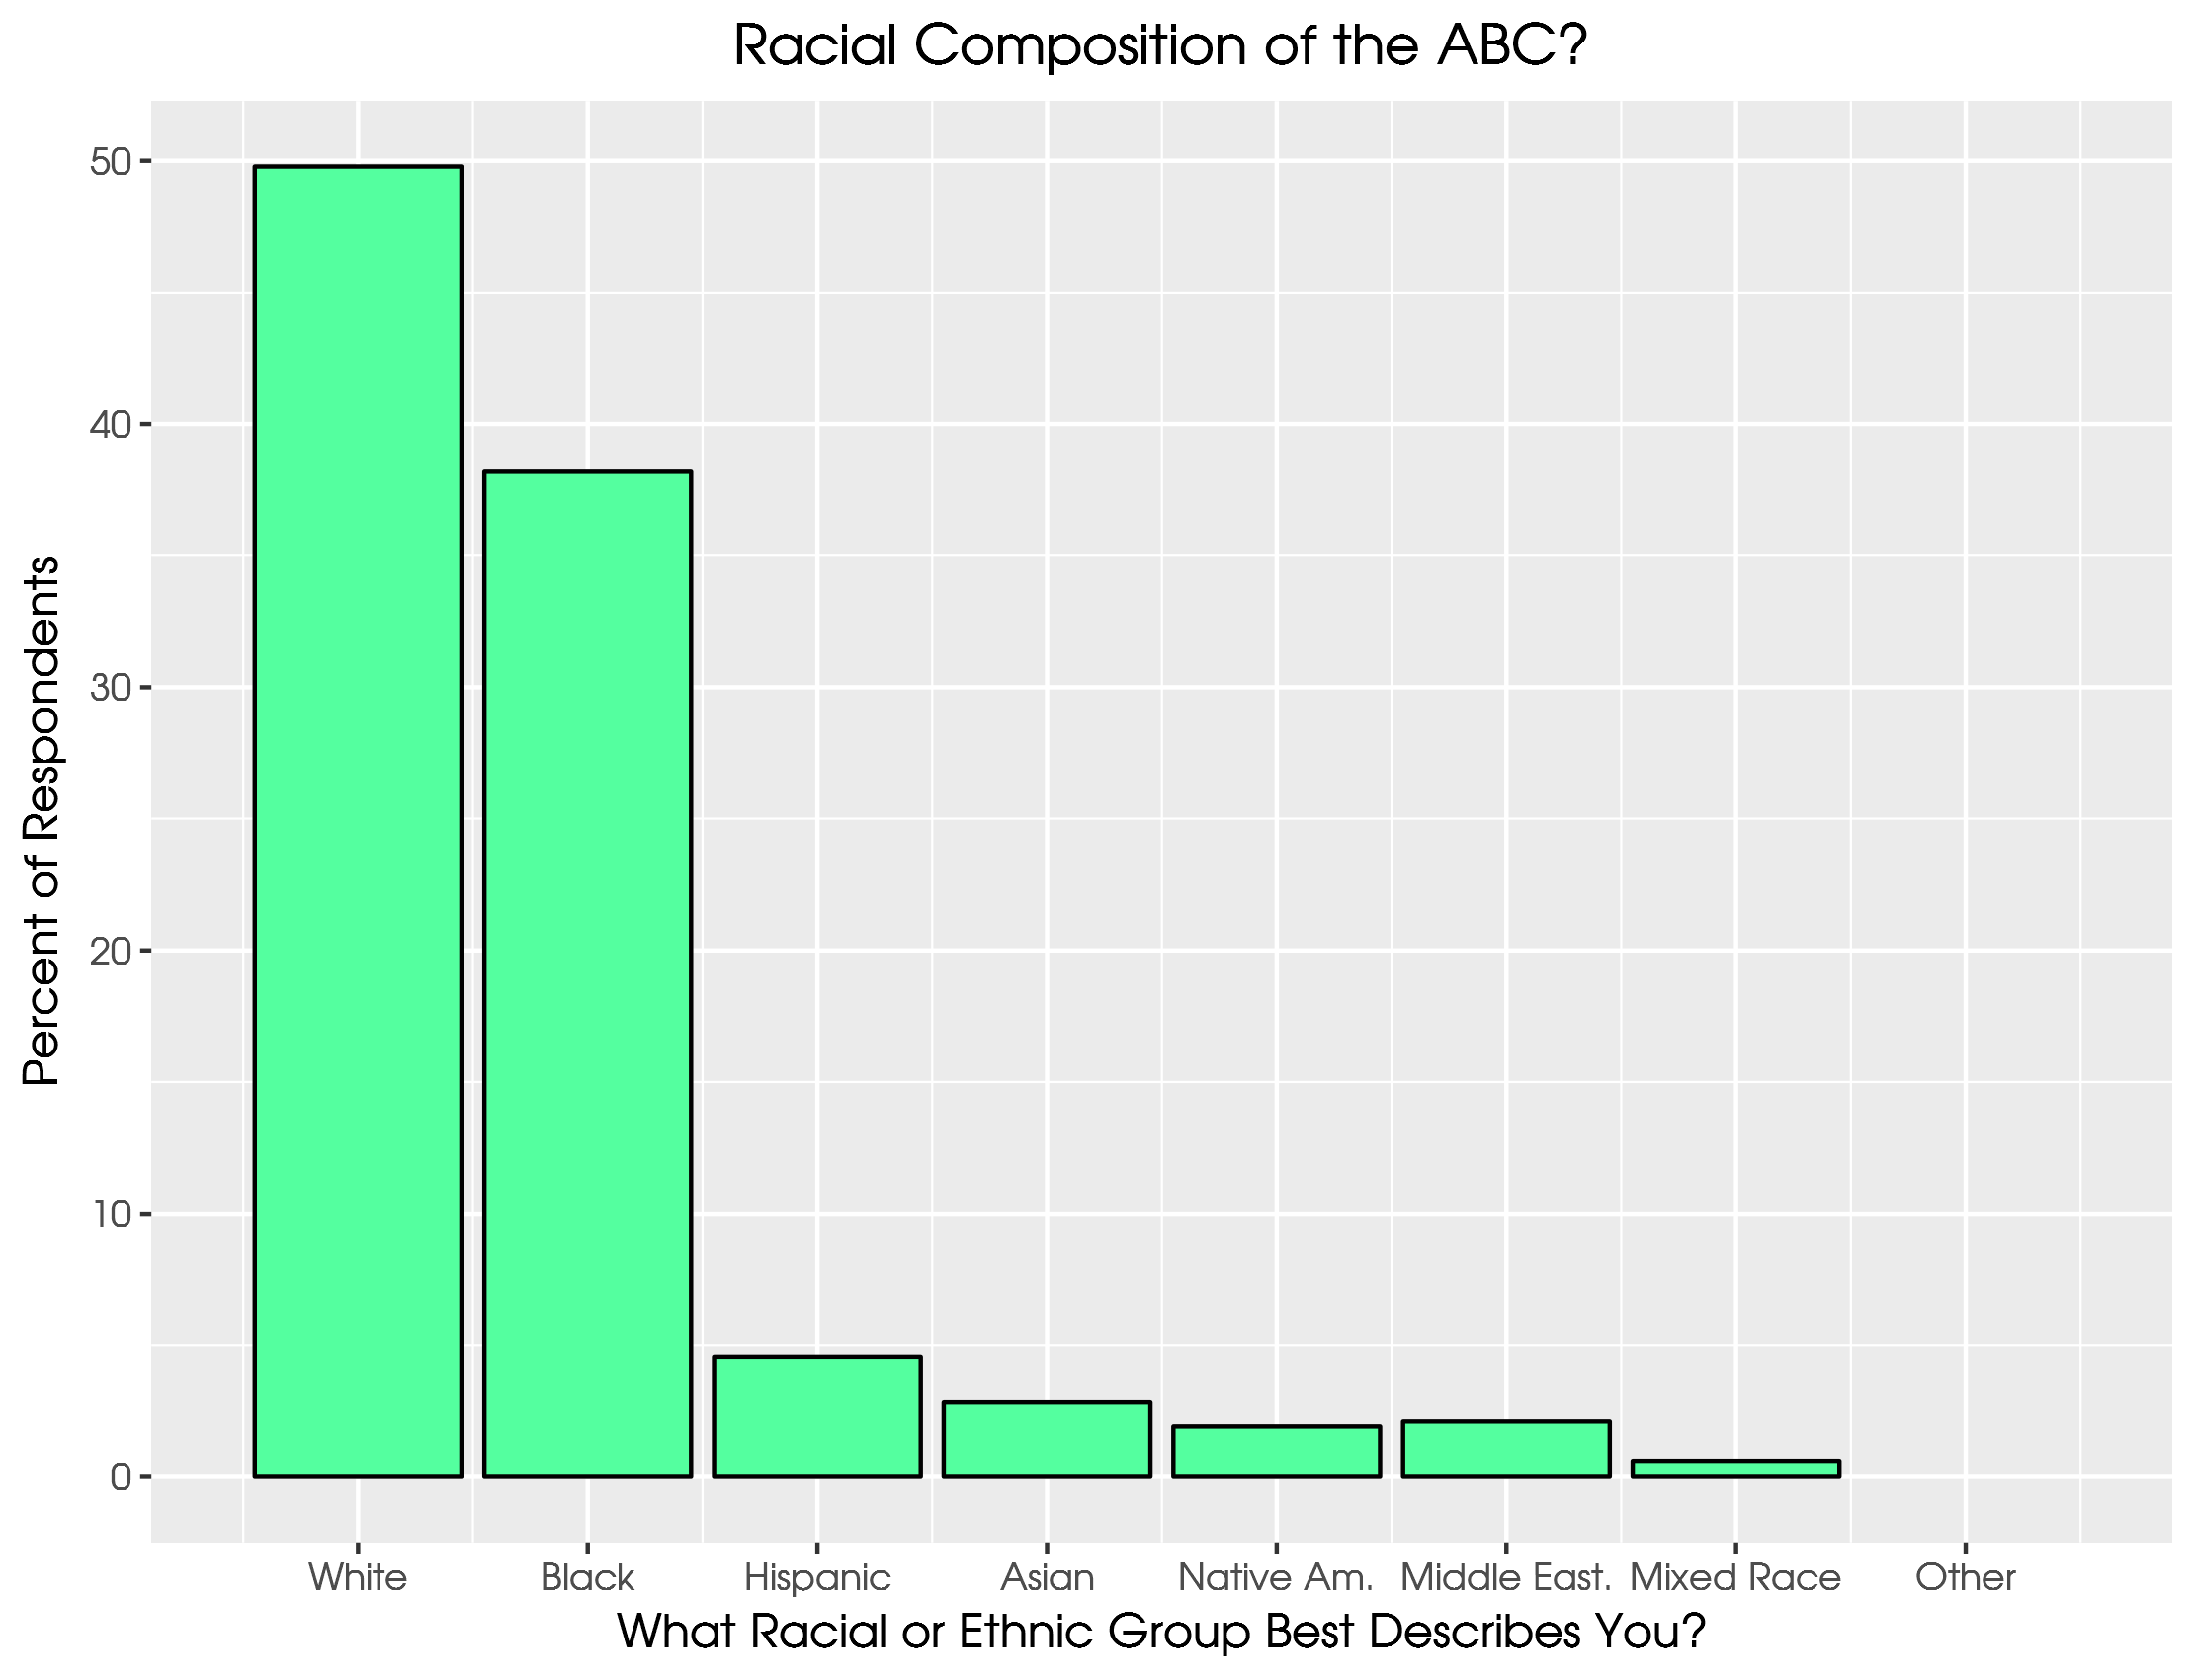
Notes:
Does this compare to what you know about ABCUSA? Do people incorrectly pick ABC on the survey?

Slide 9
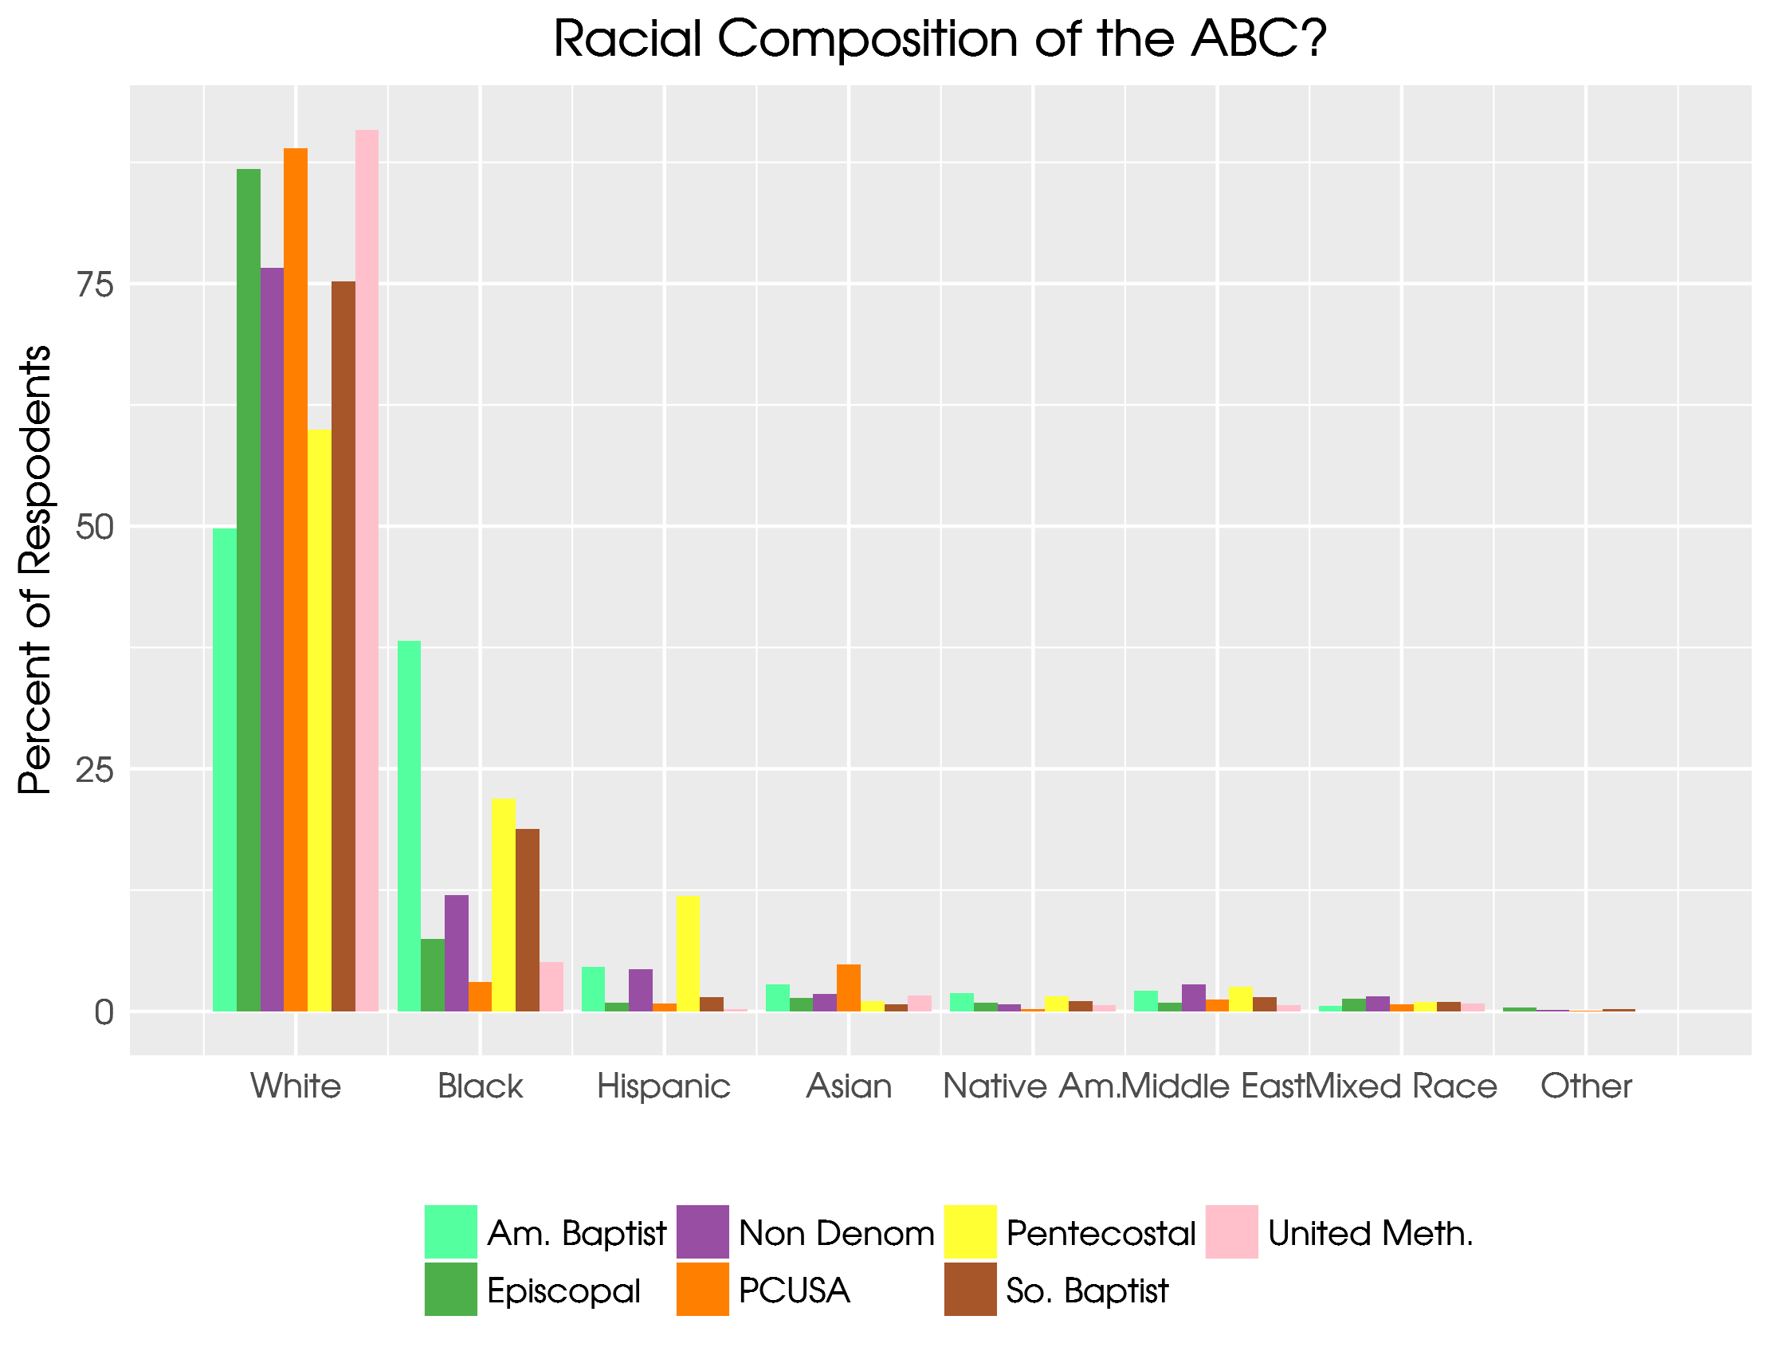
Notes:
Largest AA sample of these denoms.

Slide 10
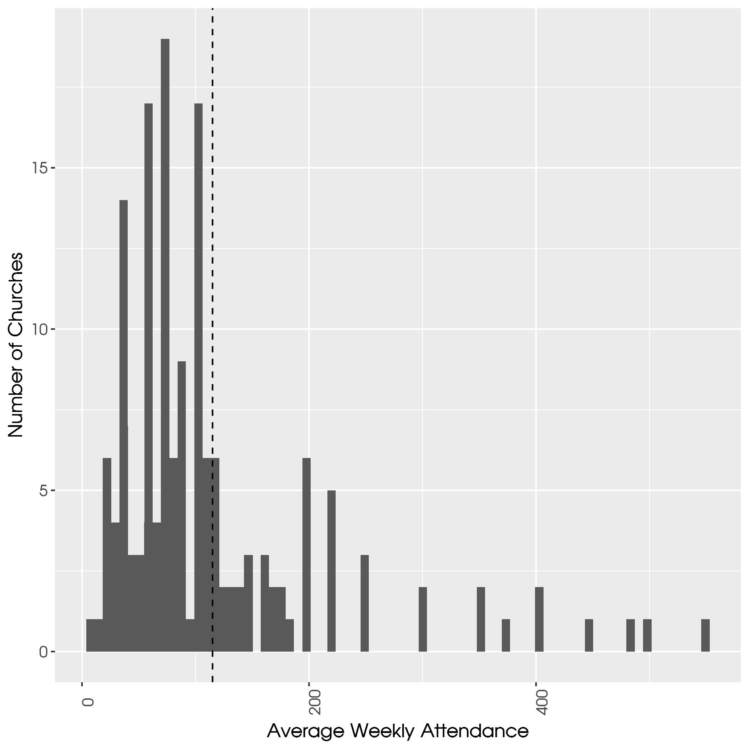
Notes:
Mean was 115. Median was 85. Max was 550. More educated pastors don’t have bigger churches

Slide 11
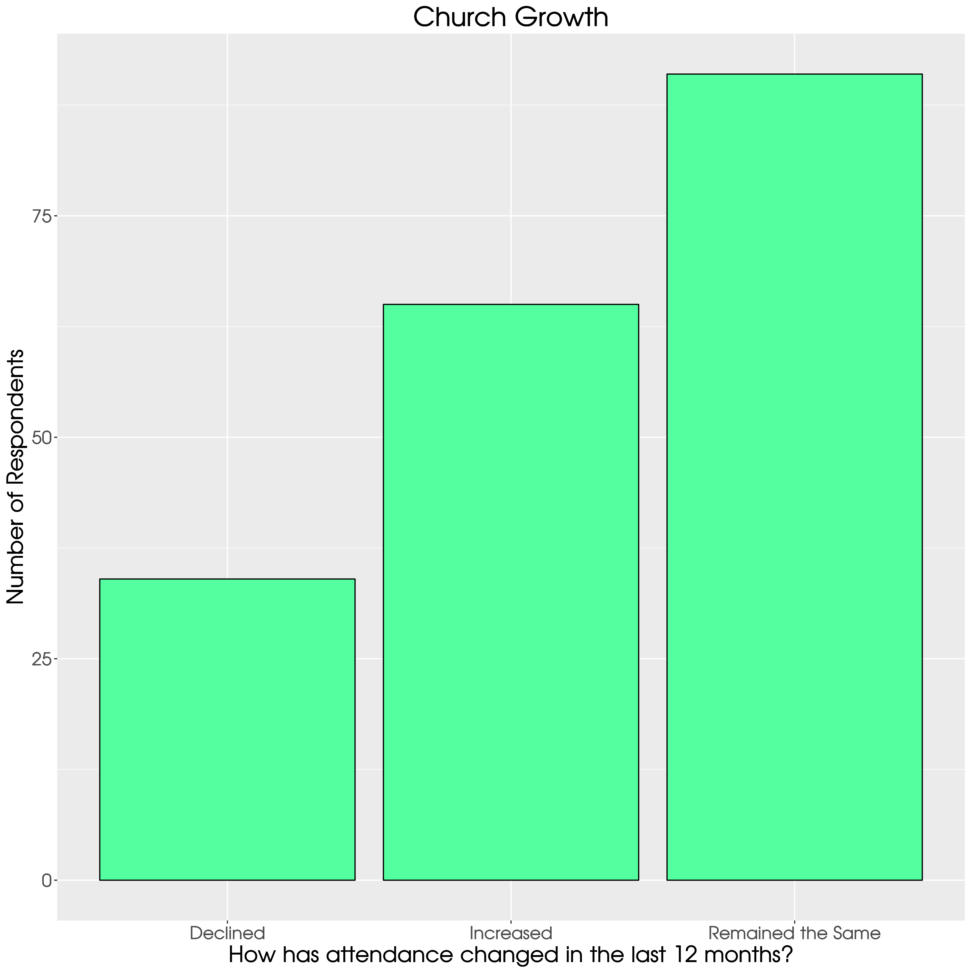
Notes:
Social desirability bias.

Slide 12
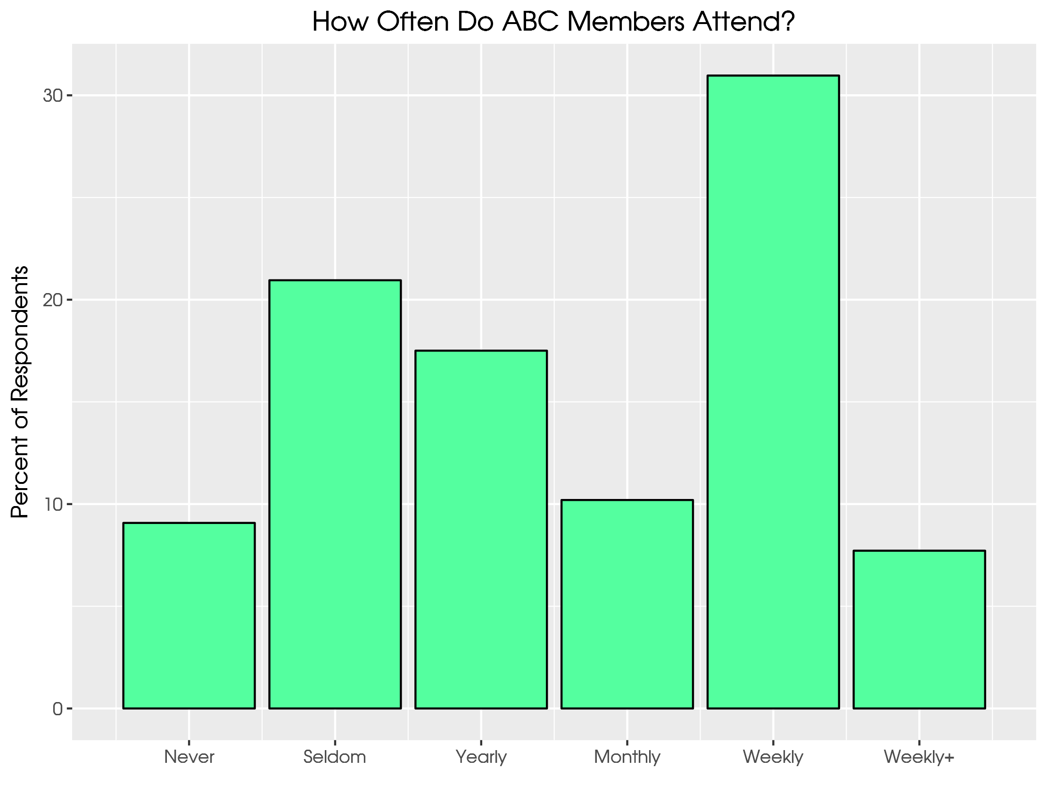
Notes:
CCES 2016. Sort of all or none. This may feed into wrongly ID’ing ABCUSA

Slide 13
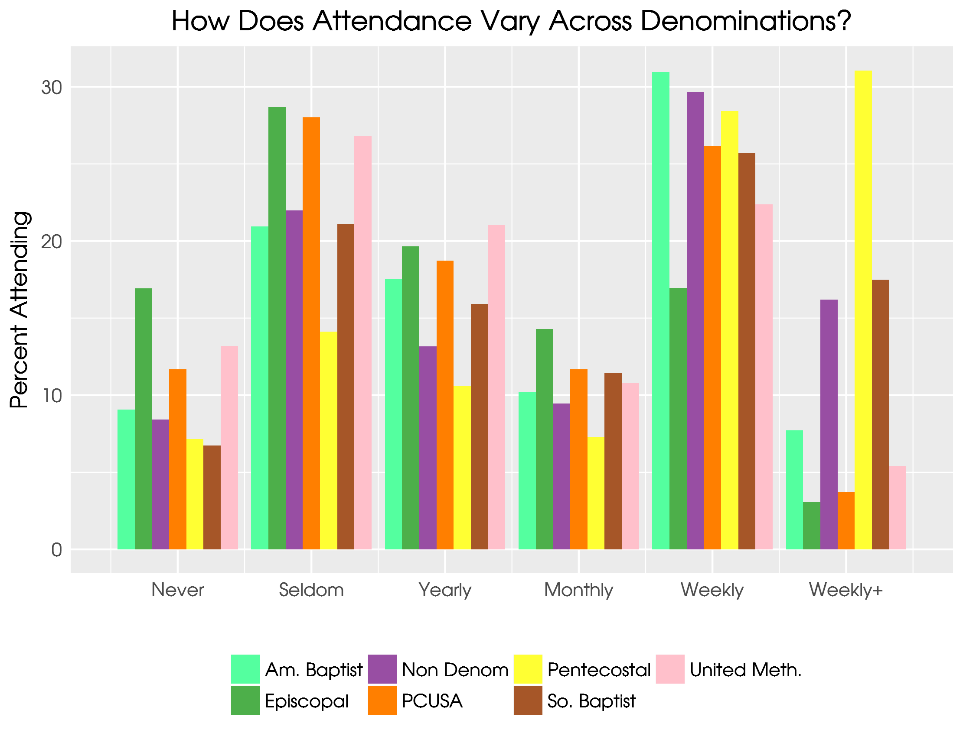
Notes:
Again, compare ABC to Episcopal. Then compare to Pentecostal or SBC.

Slide 14
How involved should your denomination be?
Does the ABC-USA need to be more or less involved with social and political issues?
Should the ABC-USA be more or less involved in debating social and political issues inside the religious body?
Should the ABC-USA be more or less engaged in presenting its social and political views to government?
Responses options range from Much Less (1) to Much More (7)
Three questions summed and indexed from 0 to 1.

Slide 15
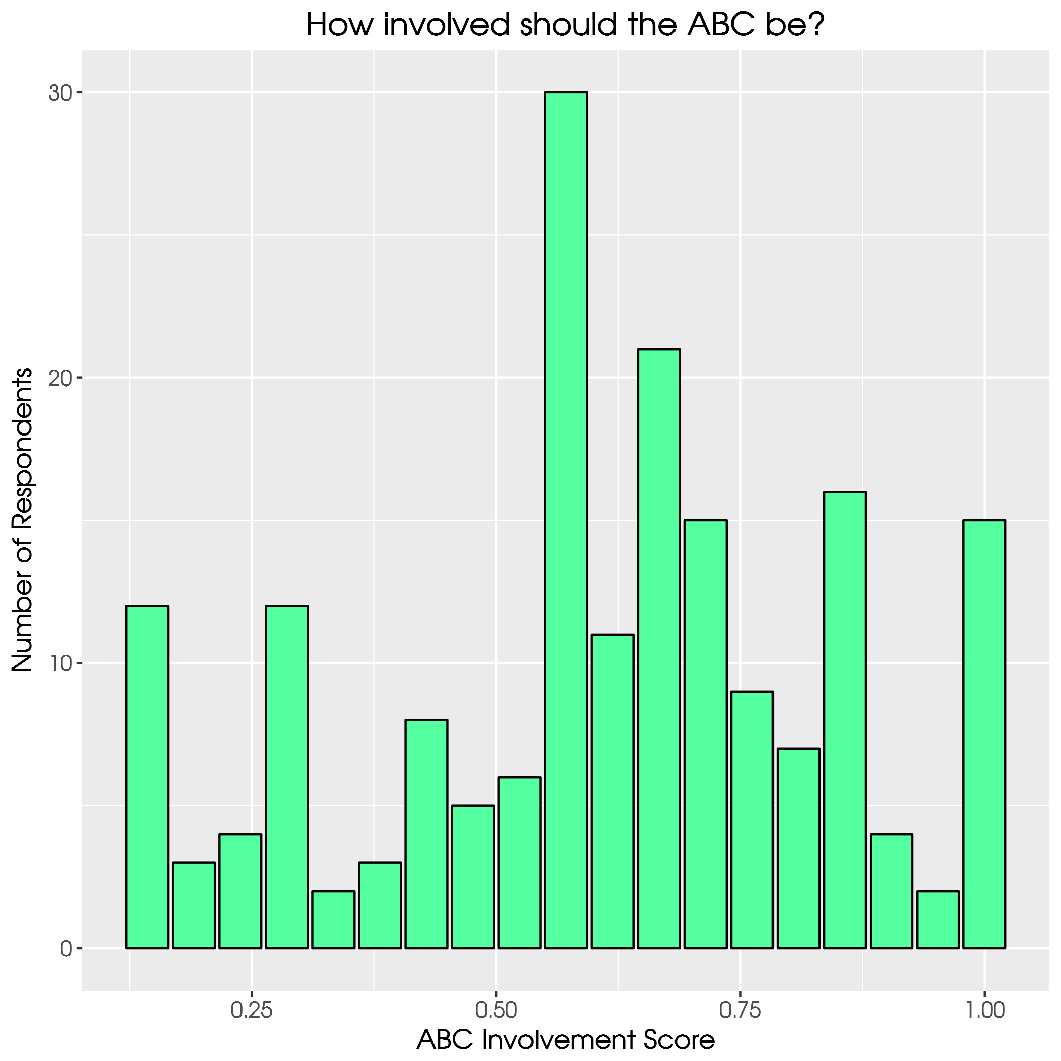
Notes:
Mean here is .51. Big differences by PID, though.

Slide 16
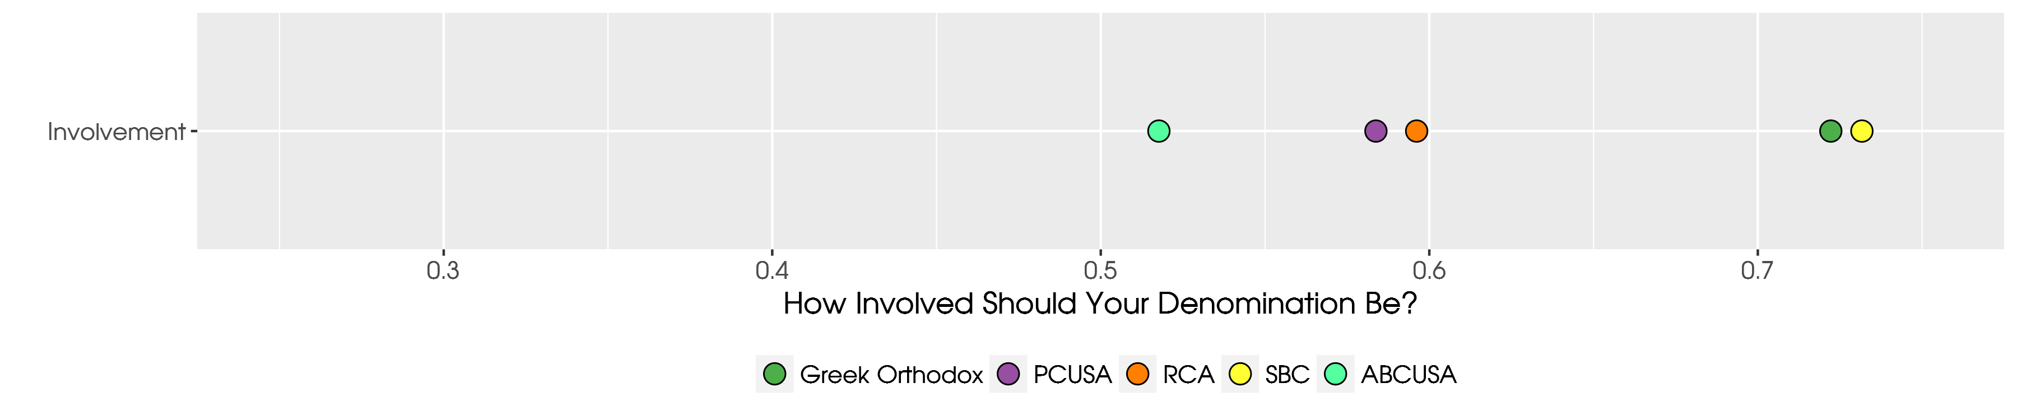
Notes:
Do liberal pastors assume ABC is liberal and want it to be more public? On to politics…

Slide 17
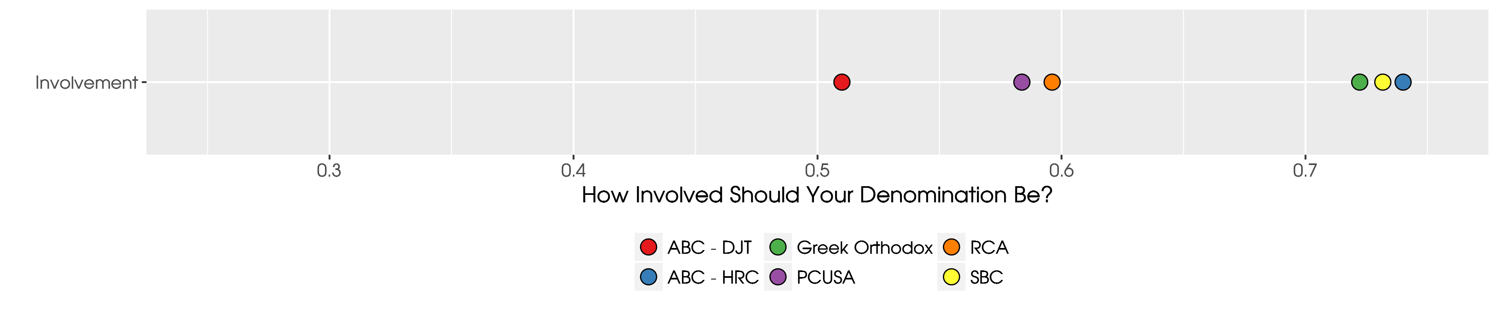
Notes:
In the aggregate ABC pastors want their church to be less involved than all others we surveyed.

Slide 18
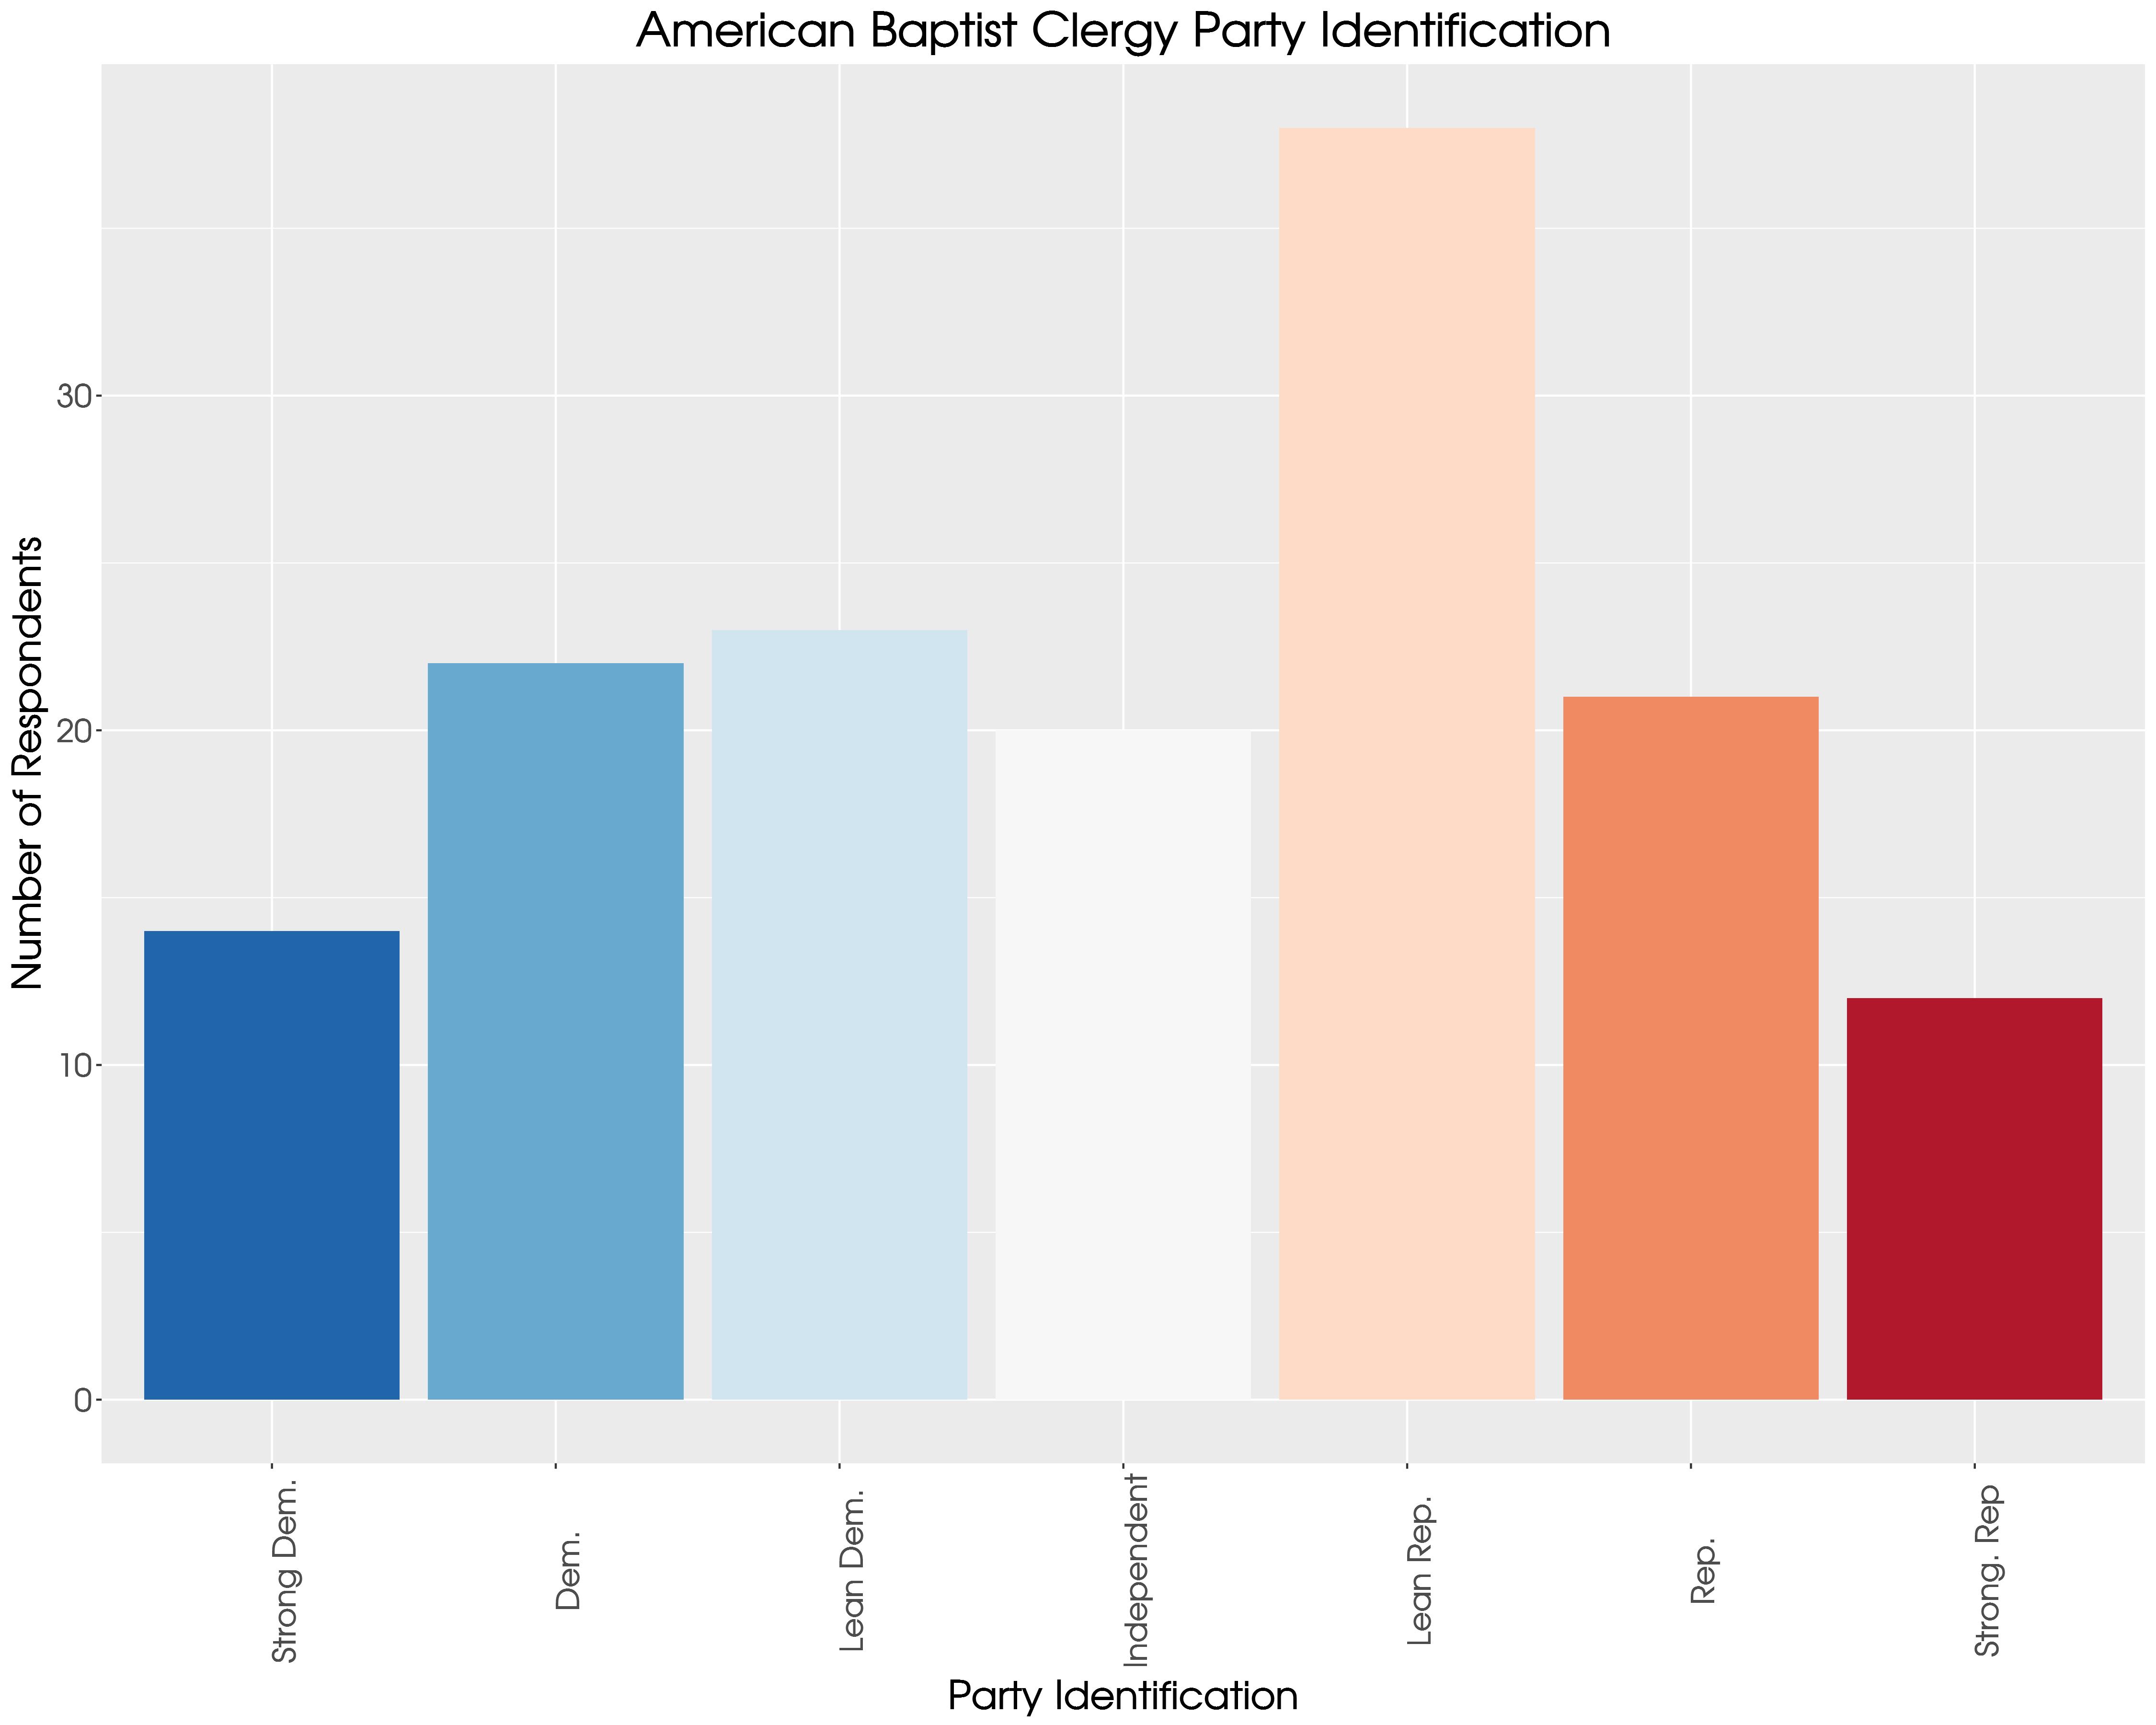
Notes:
Normal distribution.

Slide 19
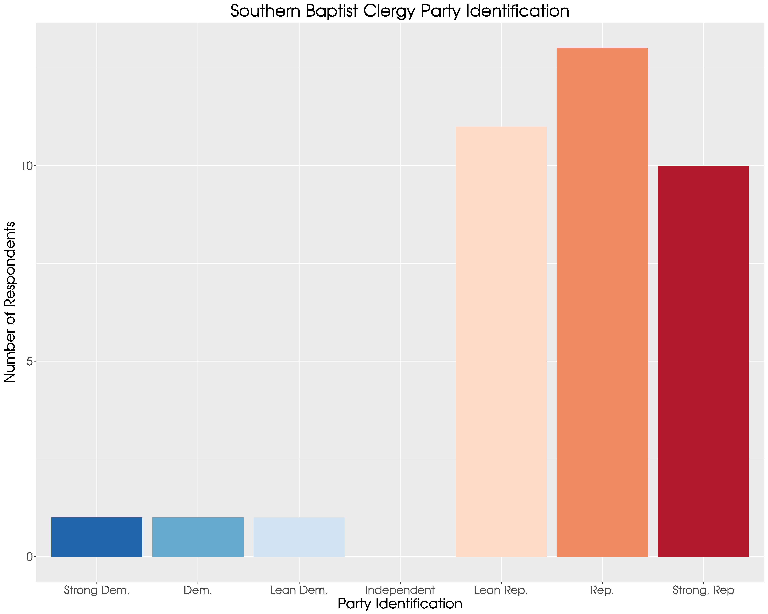

Slide 20
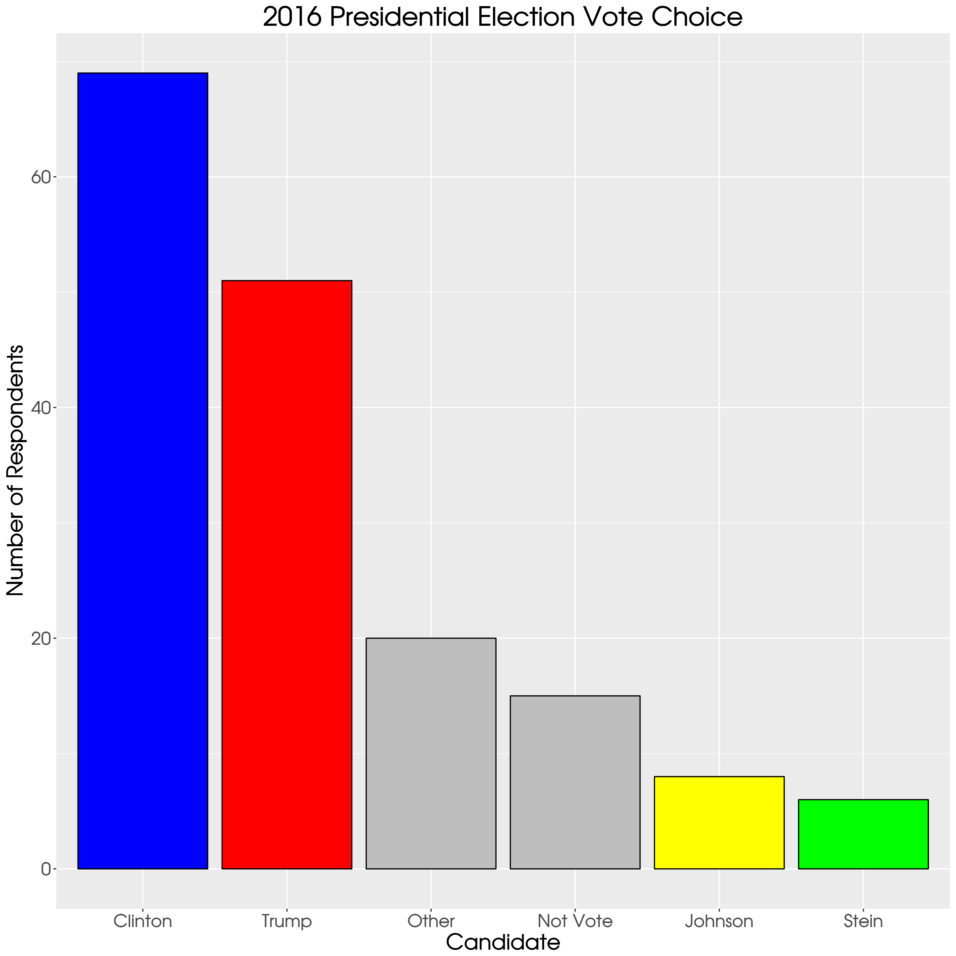
Notes:
41% for HRC. 30% for Trump. All other categories together = 29%

Slide 21
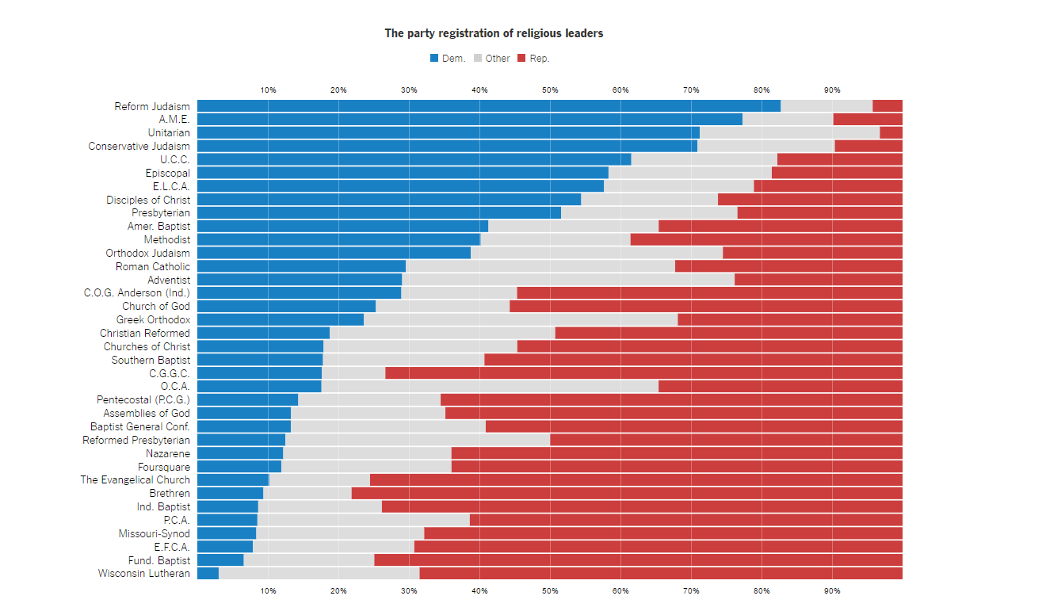

Slide 22
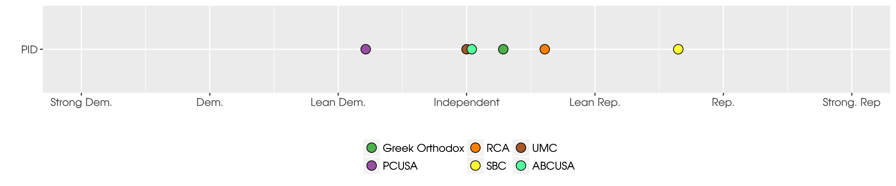
Notes:
Smack in the middle.

Slide 23
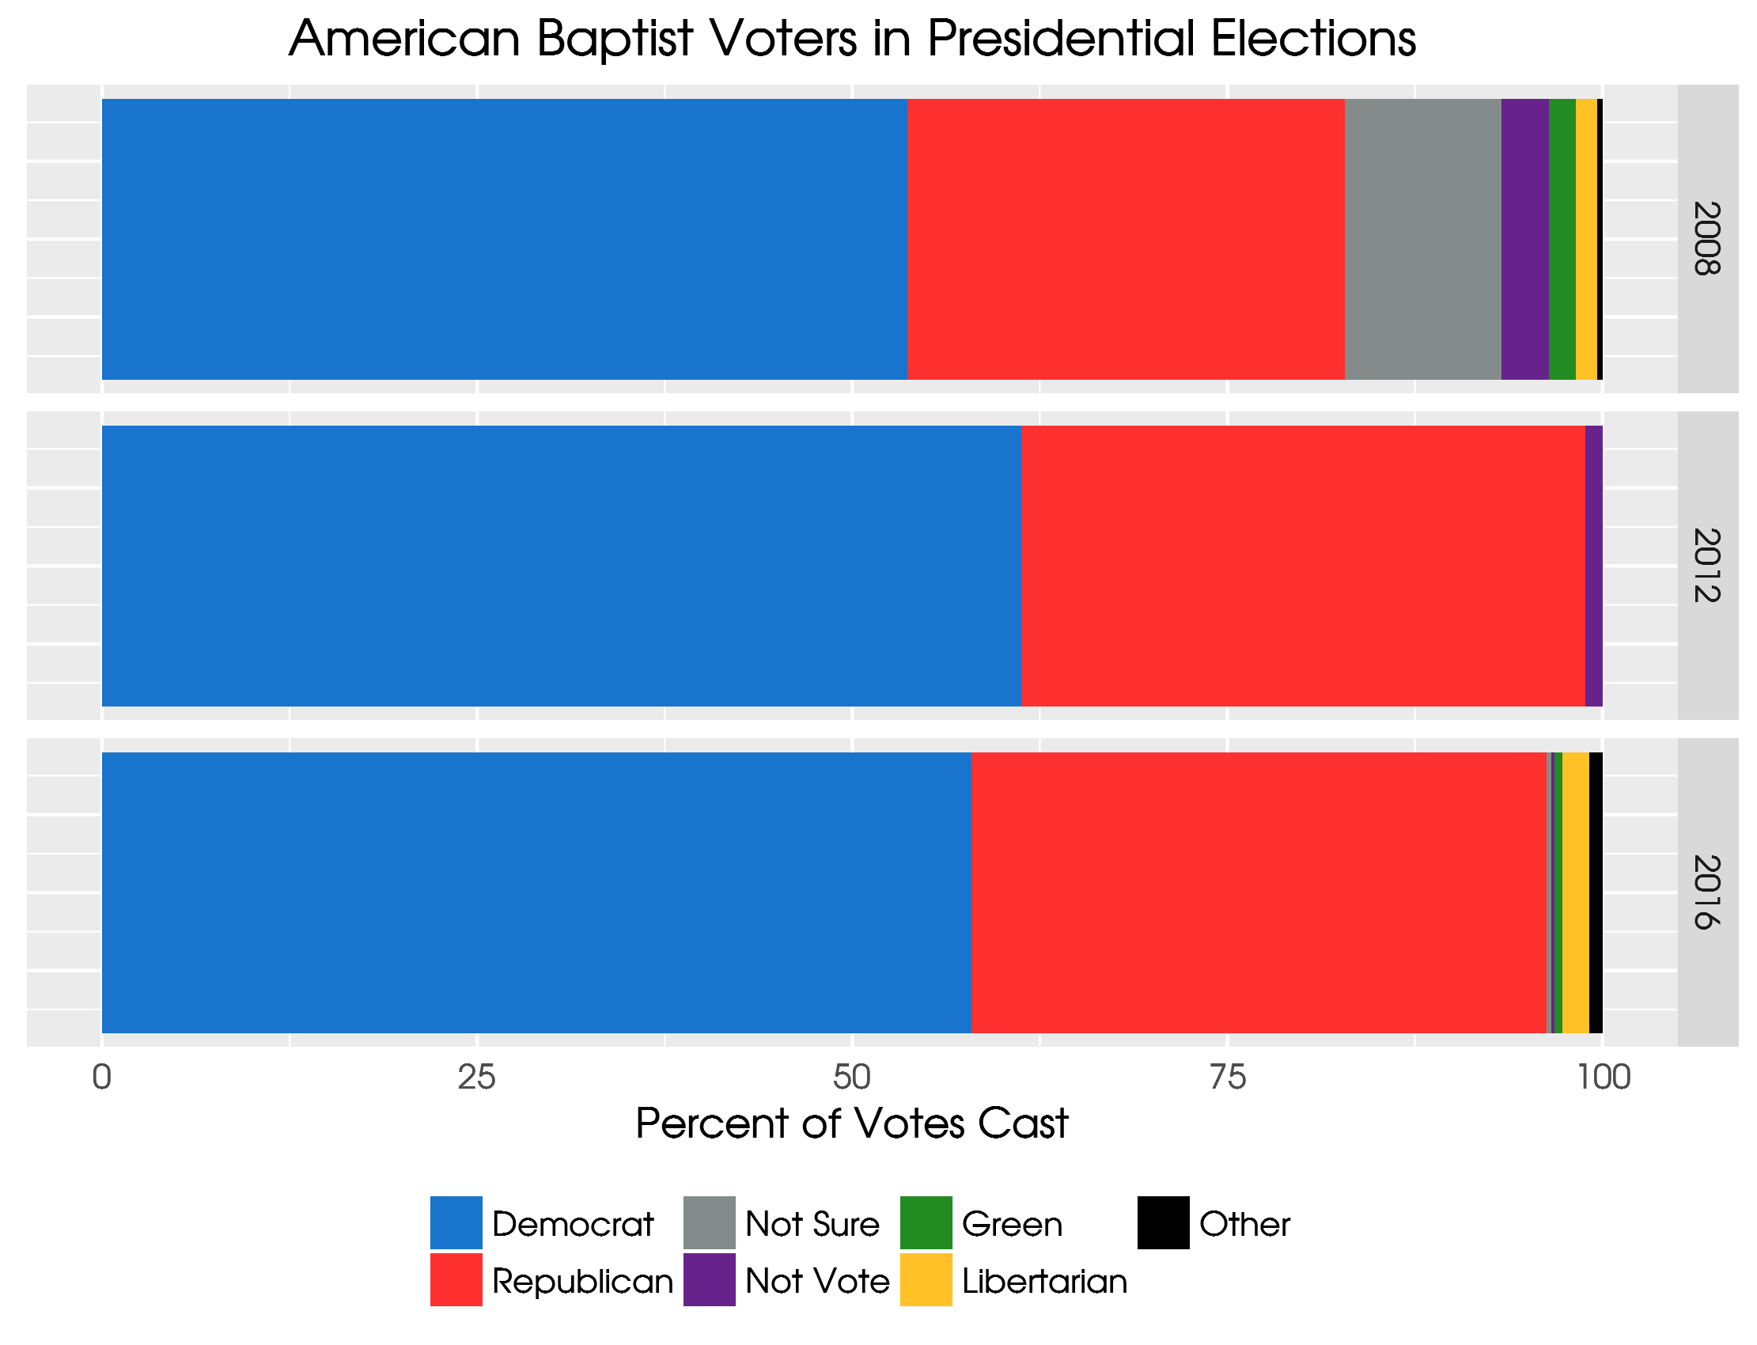
Notes:
In the 50’s for Obama. Across the board. Didn’t really change in 2016

Slide 24
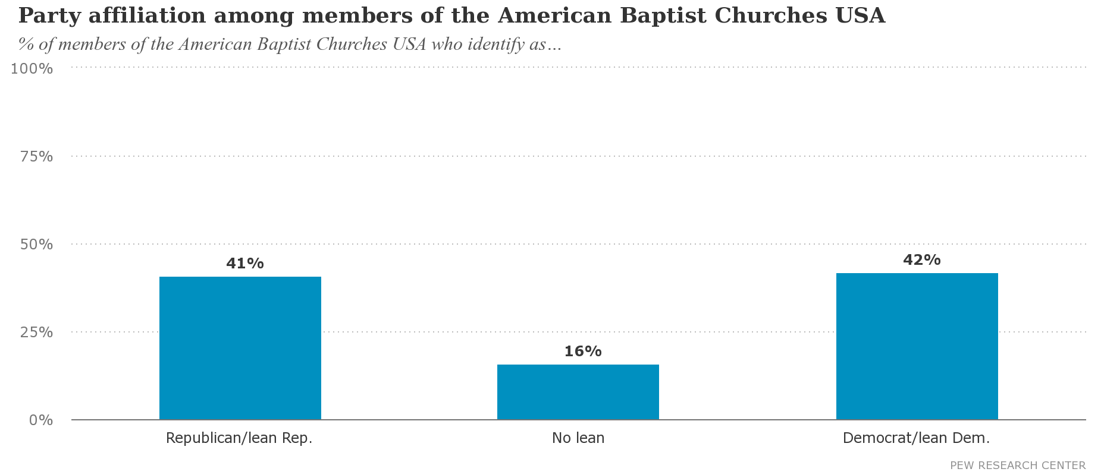
Notes:
In the 50’s for Obama. Across the board. Didn’t really change in 2016

Slide 25
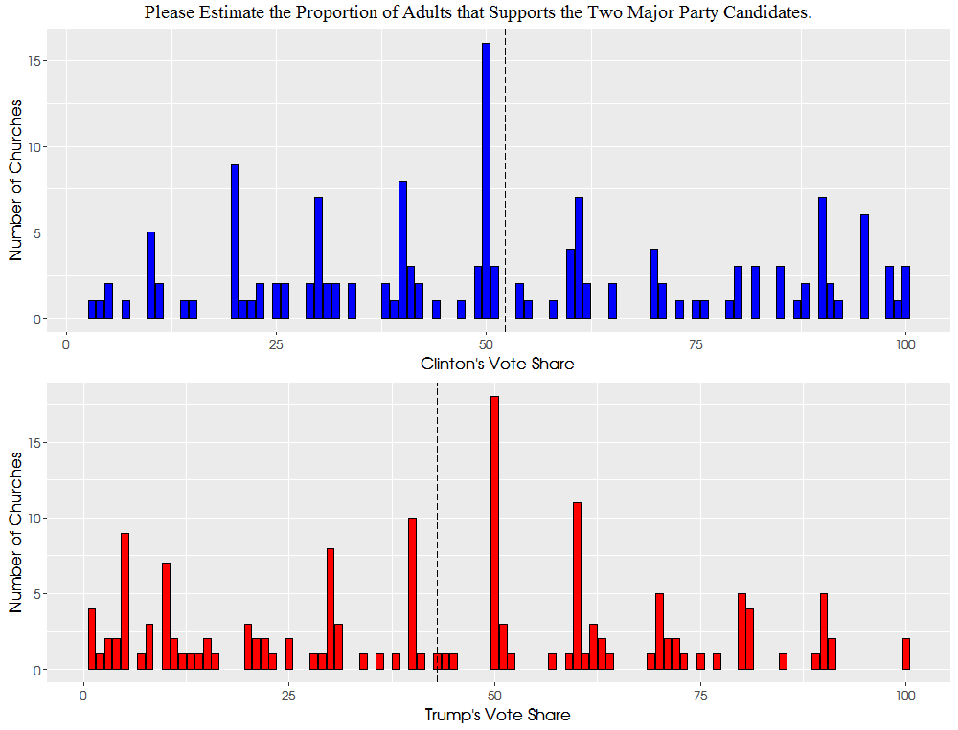
Notes:
Clergy guessing about their congregations. Pastor’s perceive it pretty correctly compared to overall data.
BUT!

Slide 26
A note on clergy perceptions of the congregation’s politics
The average vote share for Clinton was 52.2% and the average vote for Trump was 43%.
Trump voting clergy believe that, on average, 67% of their congregations are Trump supporters
Clinton supporting clergy perceive that 68% of their congregants are like them politically
Liberal clergy are finding liberal congregations, and conservative clergy find like minded churches
Notes:
How is this sorting process happening? Area ministers? Urban vs. Rural? Racial?

Slide 27
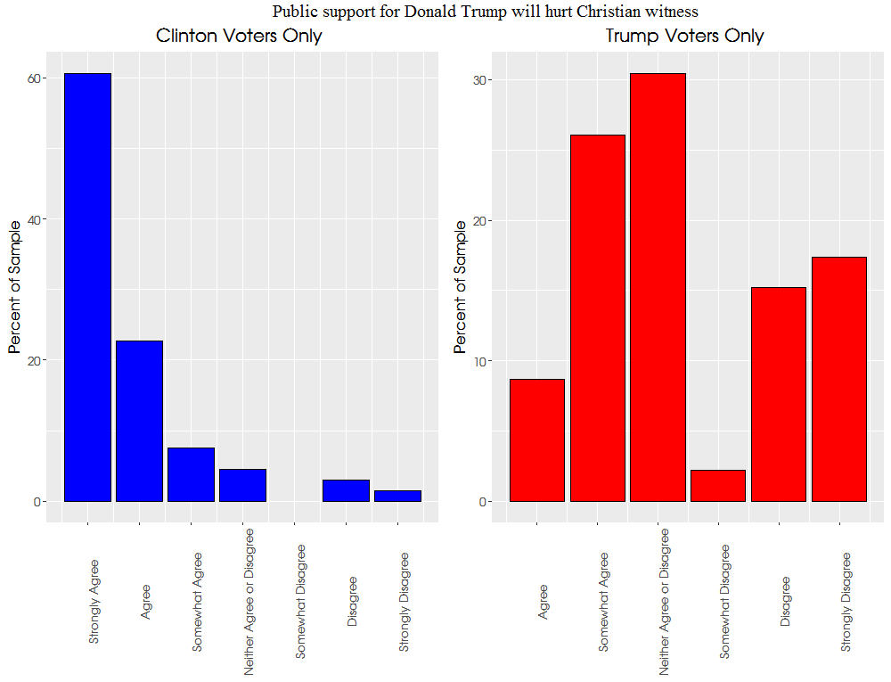

Slide 28
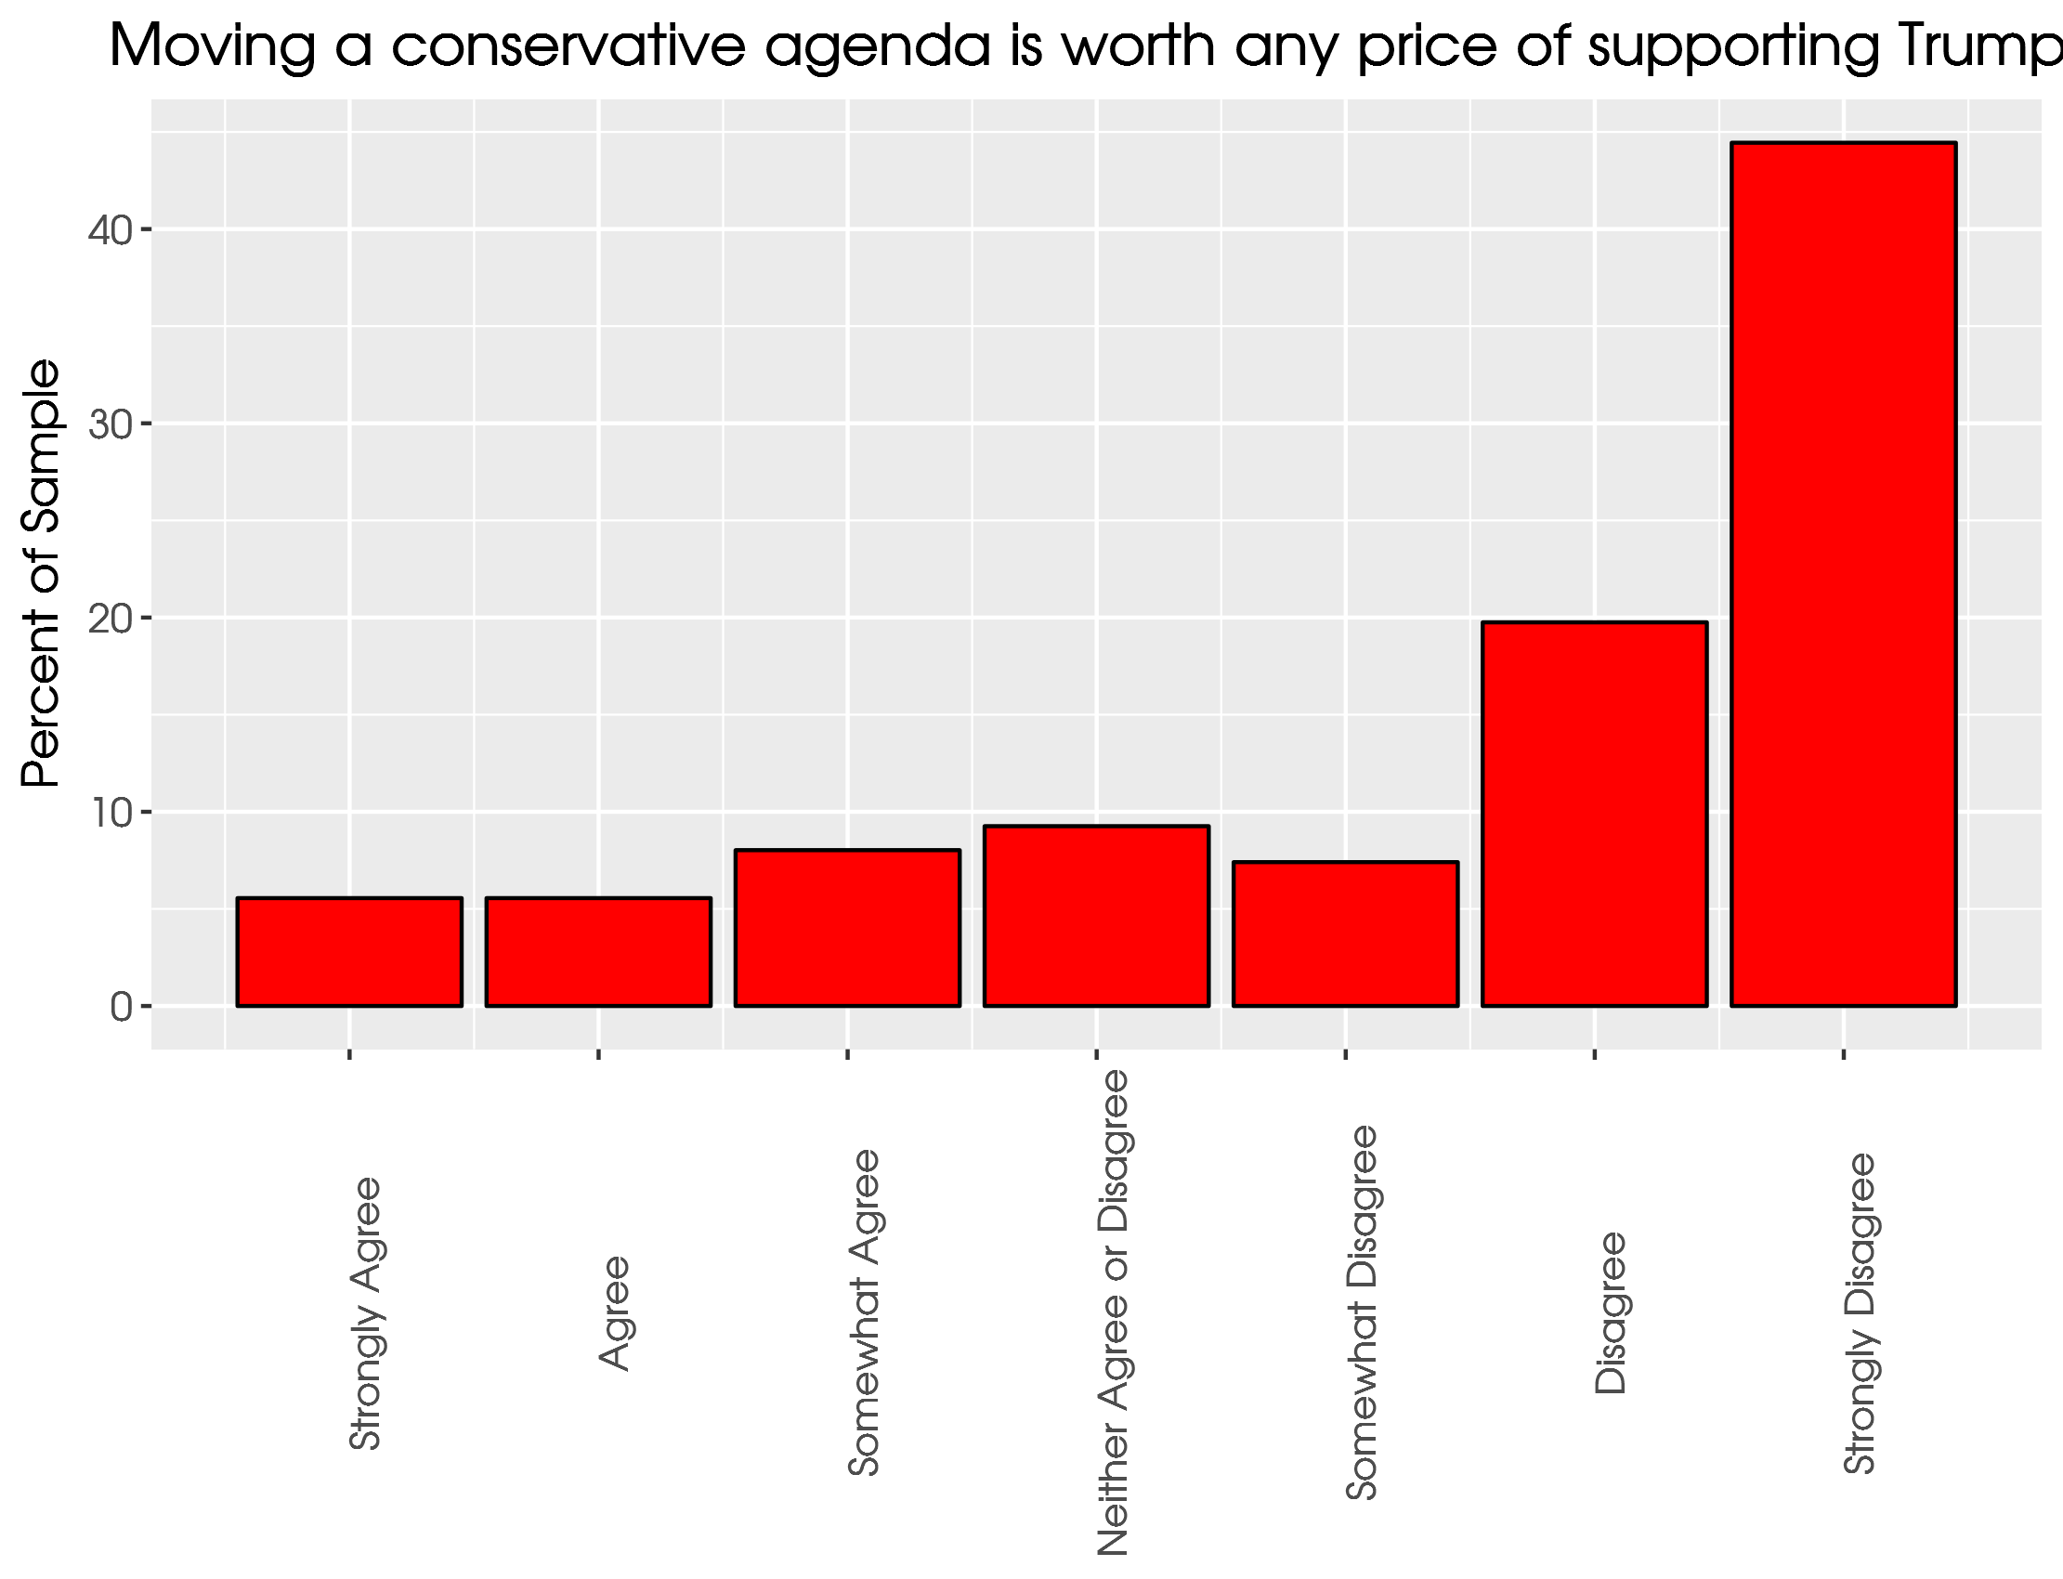

Slide 29
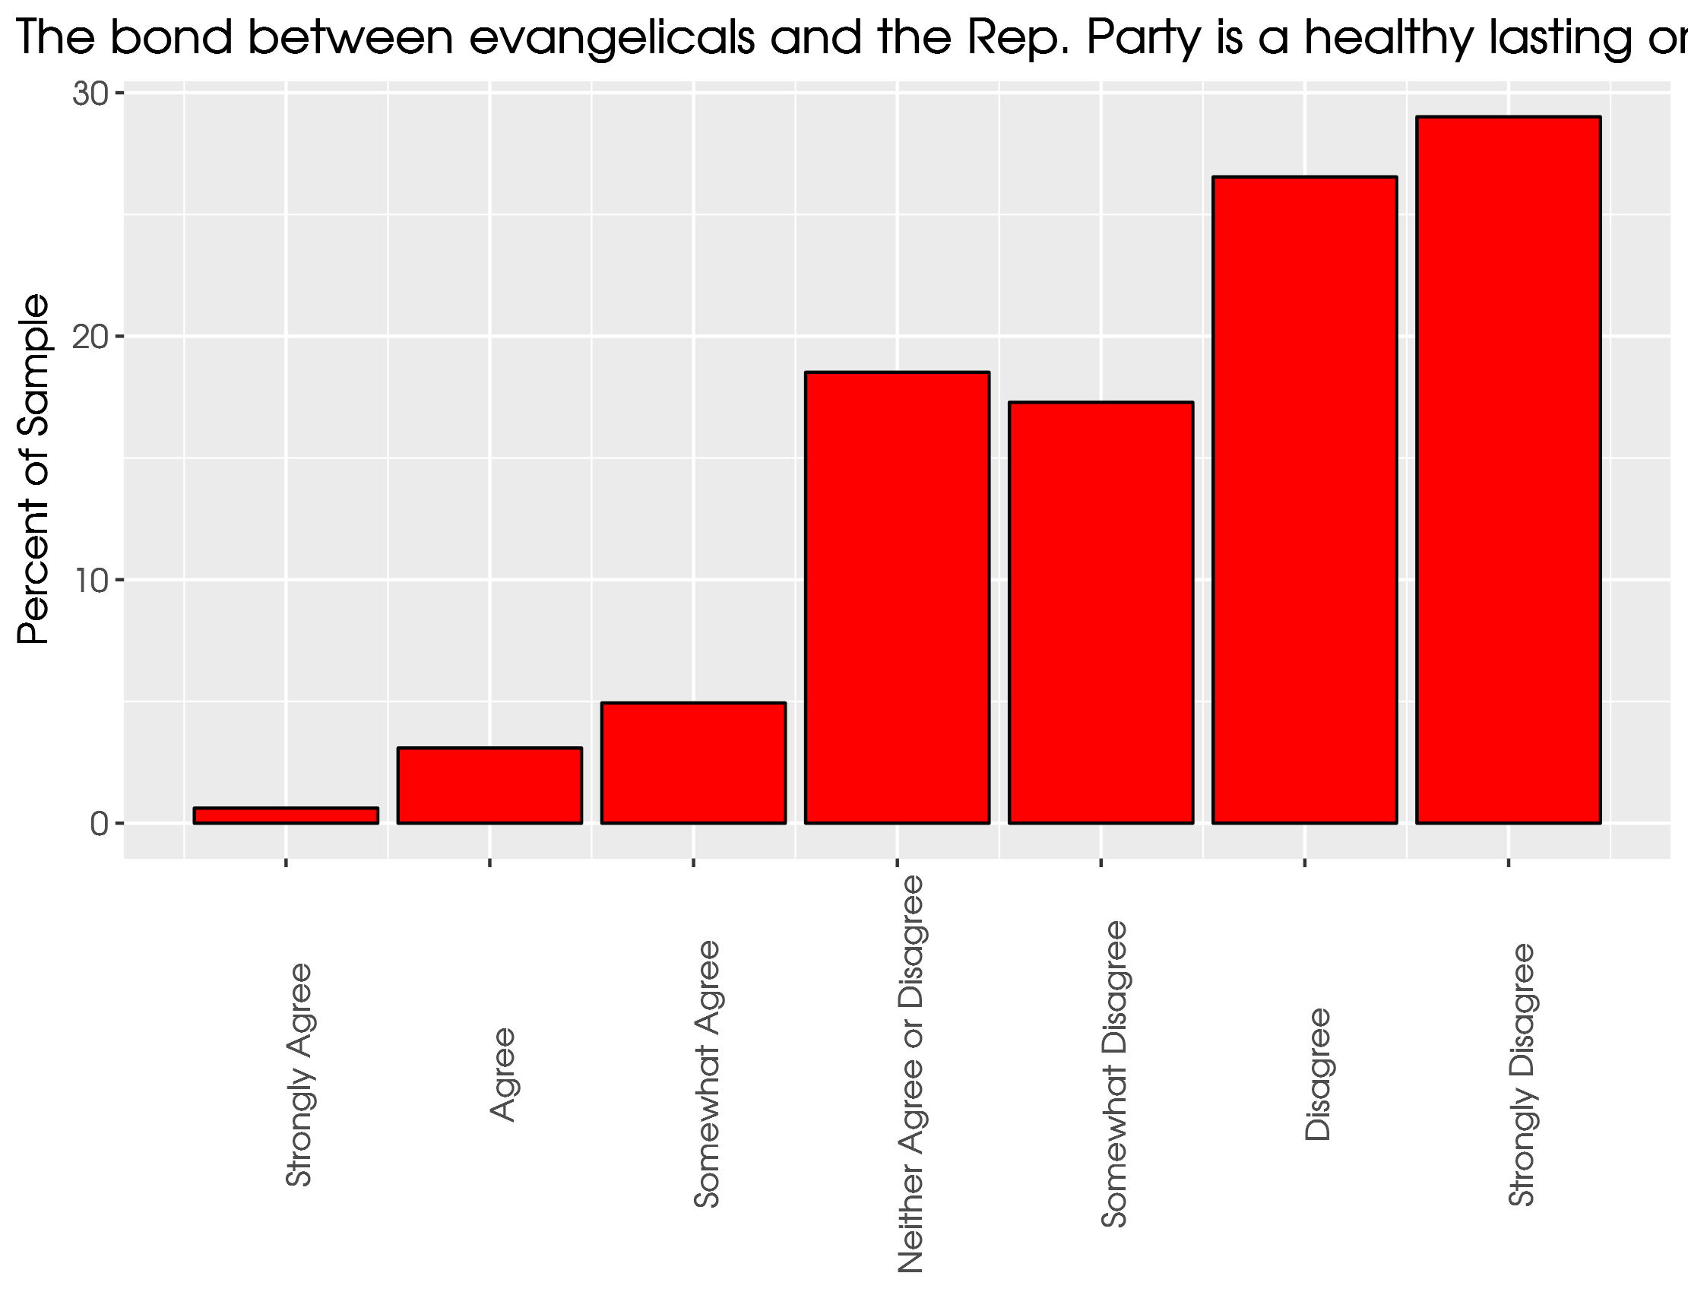
Notes:
ABC clergy are uncomfortable with the closeness in religion and GOP

Slide 30
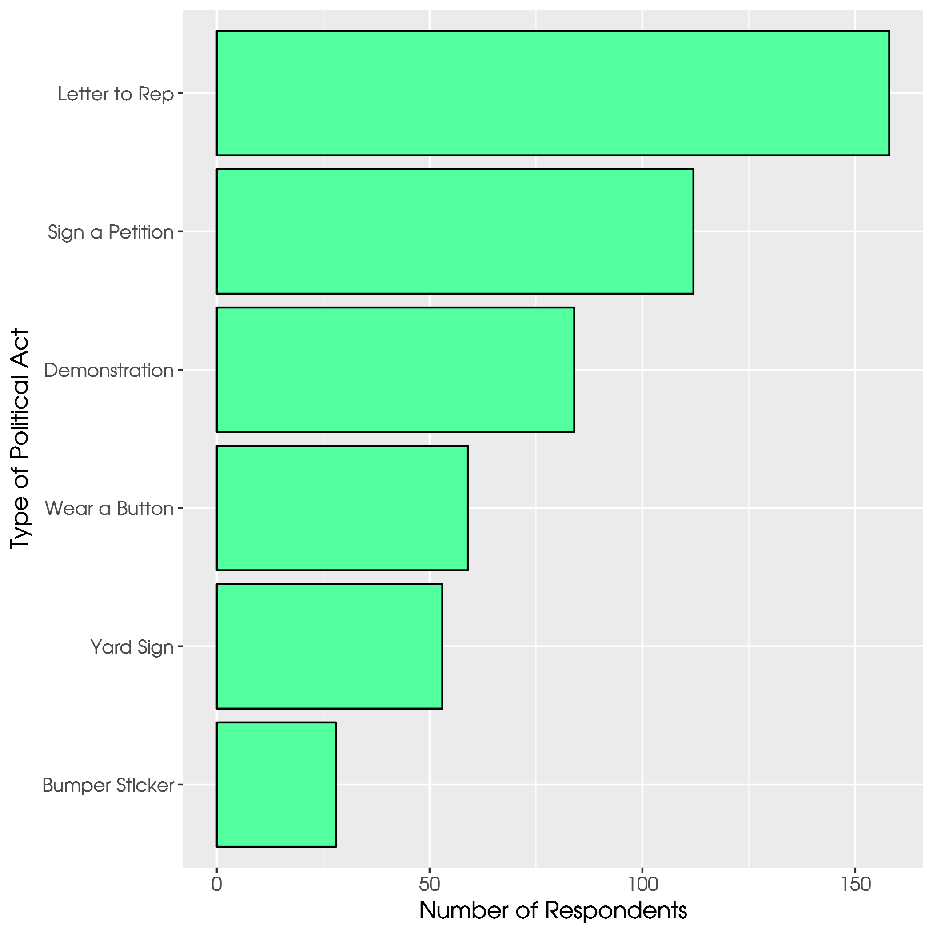
Notes:
Private acts vs public acts.

Slide 31
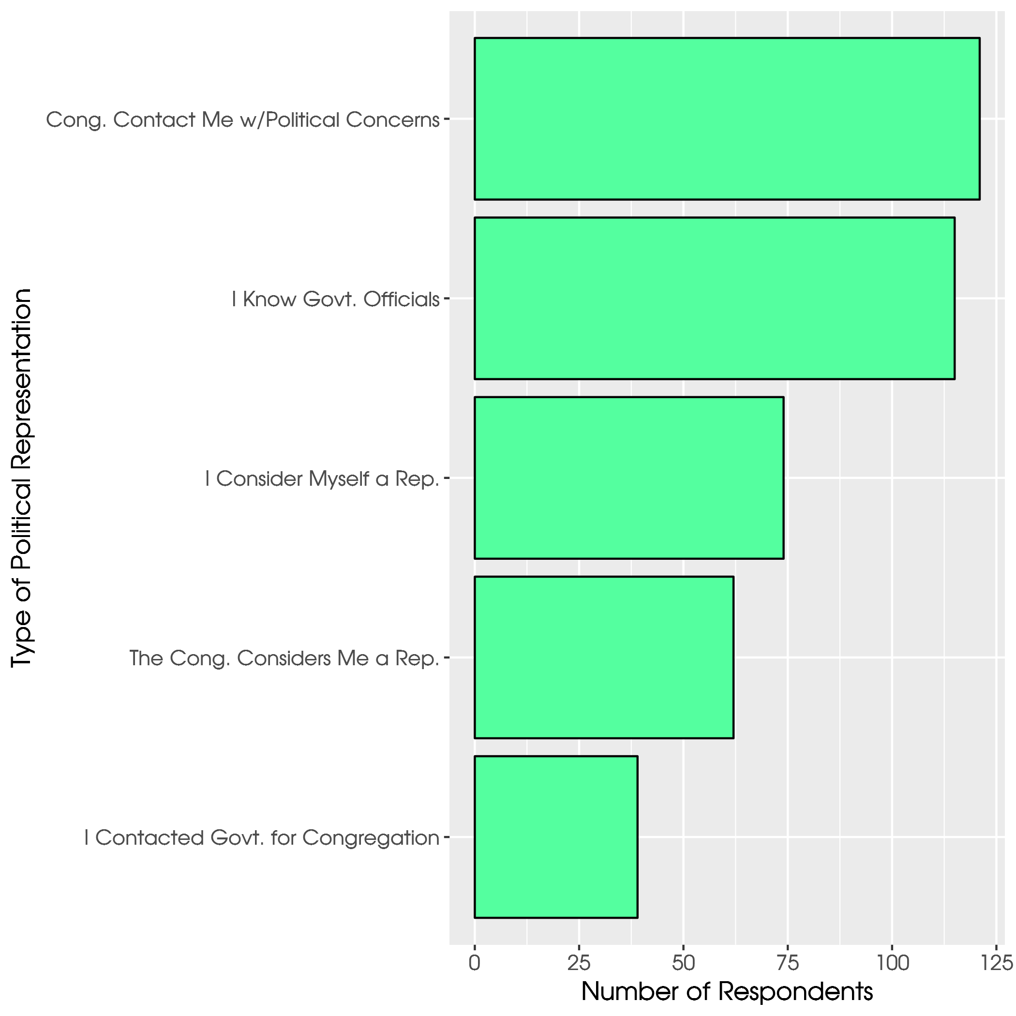
Notes:
Is the ABC equipping pastors on how to deal with this? They are well connected and are being asked but aren’t following through.

Slide 32
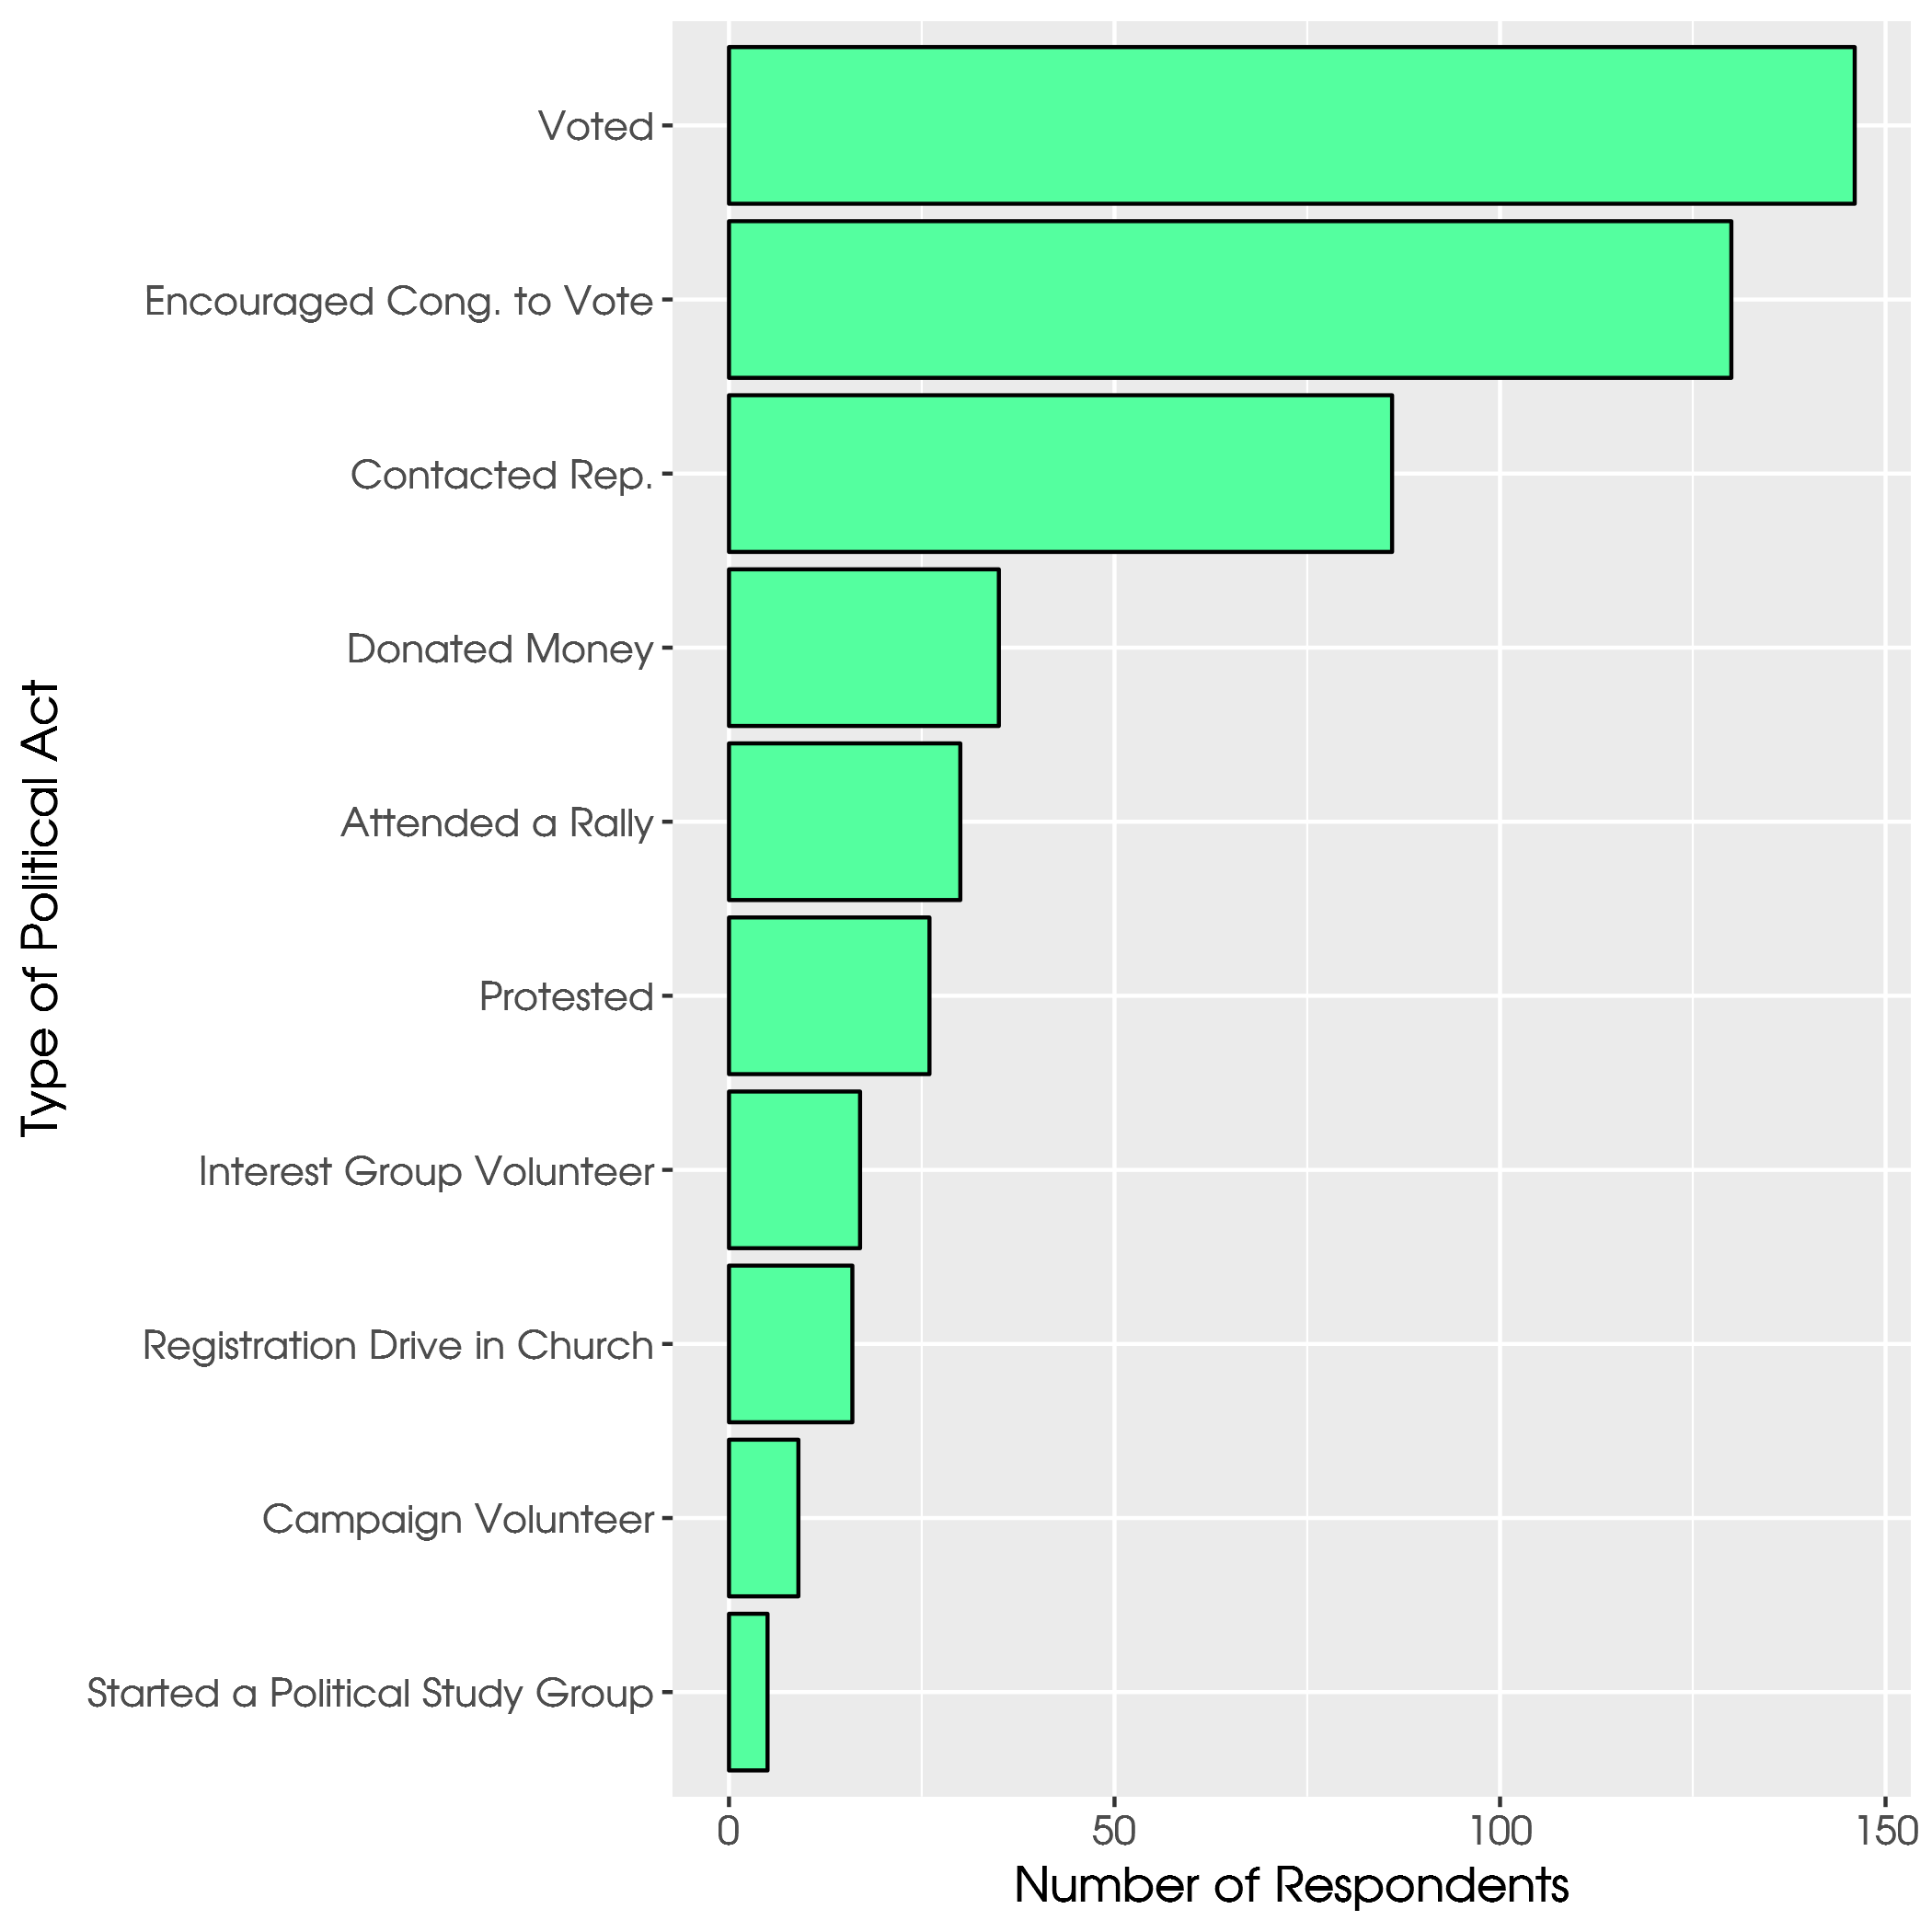
Notes:
Again, public vs private.

Slide 33
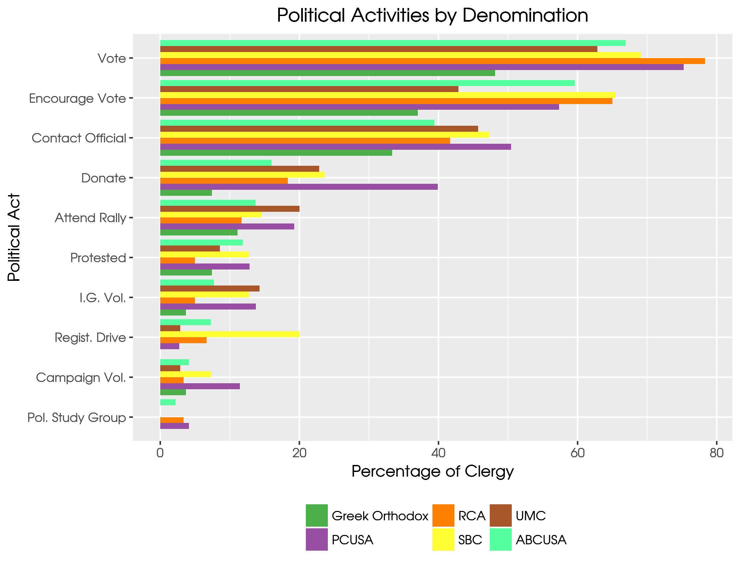
Notes:
Other ML denoms are more likely to donate or rally.

Slide 34
Religious Theology Questions
Jesus was born of a virgin
Men are given authority over women.
The Bible is literally true.
Jesus will return to earth in bodily form.
The devil exists
There is an objective standard of right and wrong established by God's Word.
Respond: Strongly Disagree to Strongly Agree

Slide 35
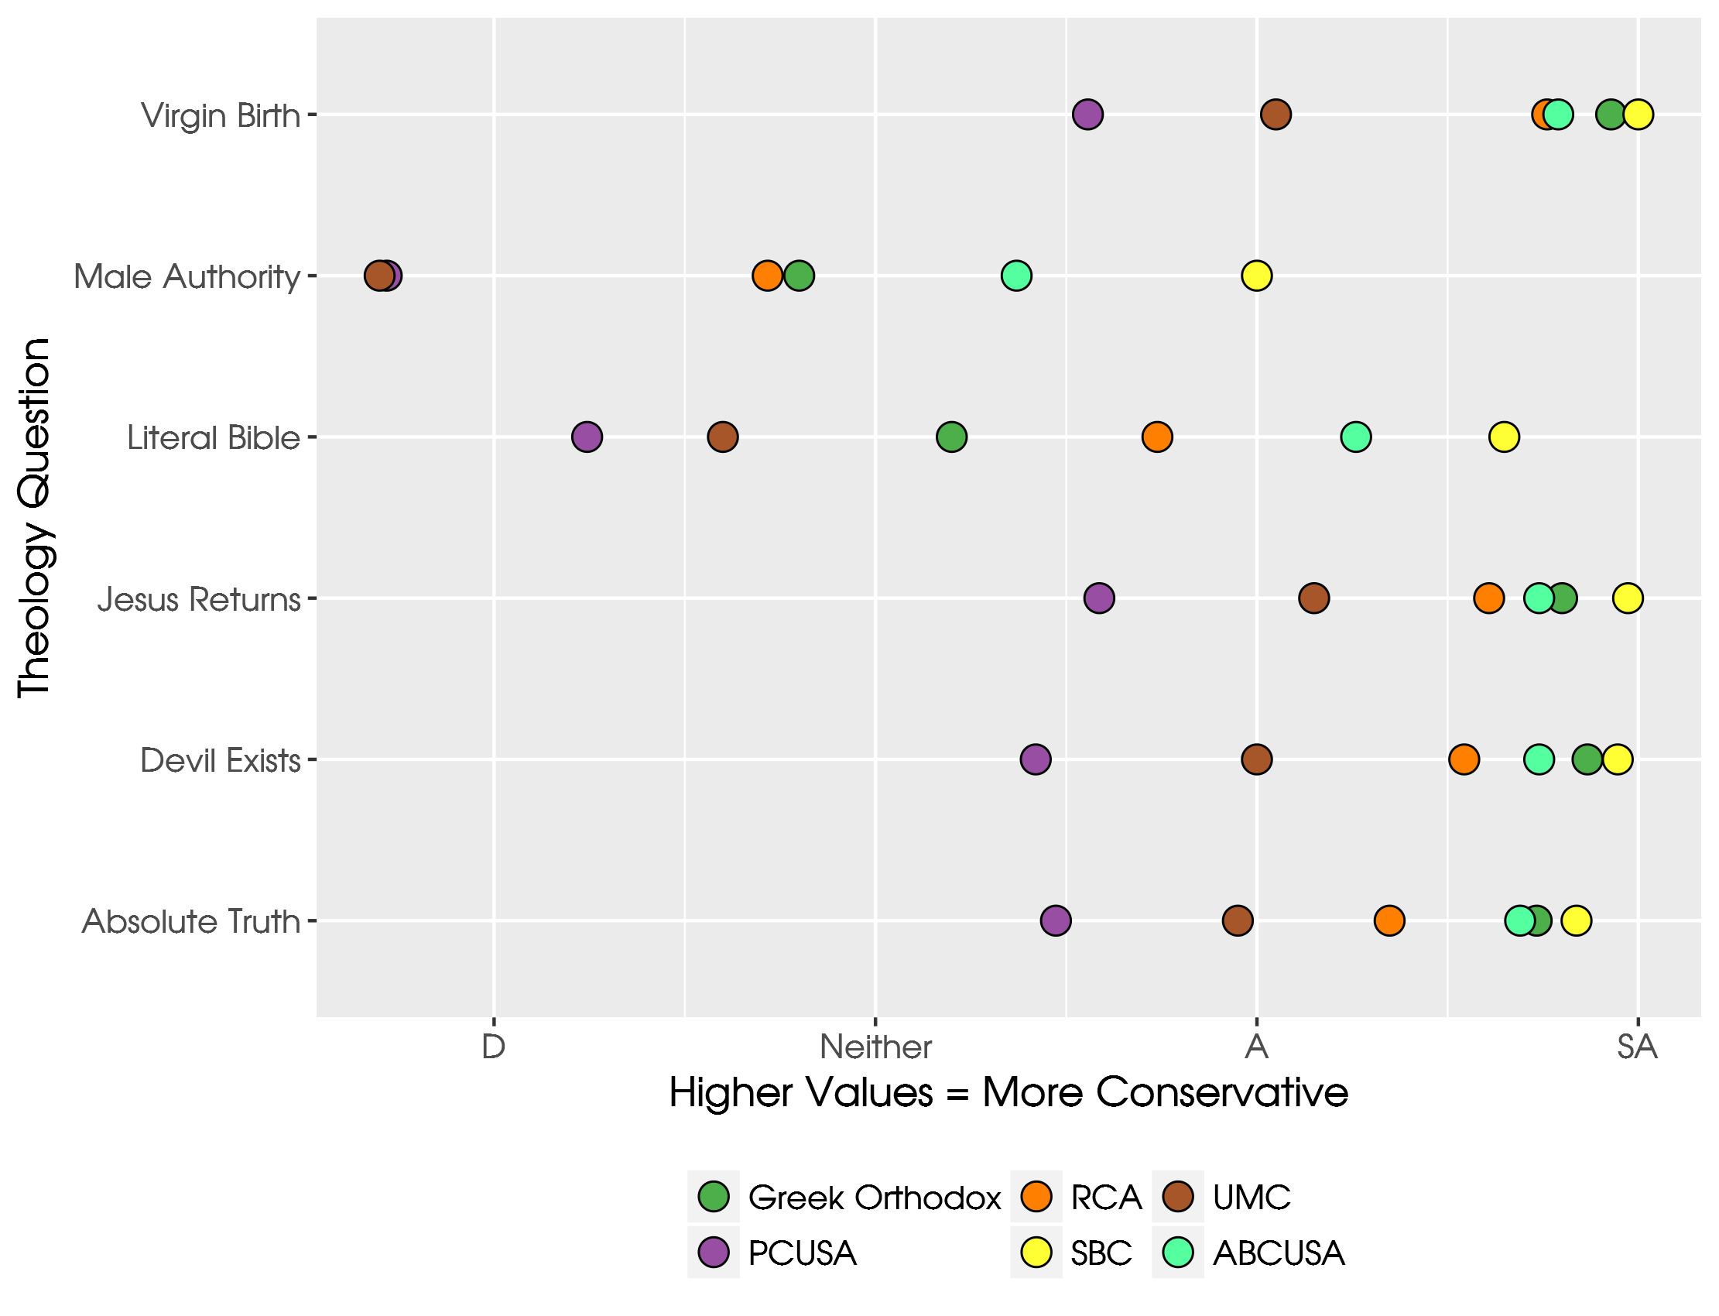
Notes:
ABC is essentially in the middle. ML to the left. SBC to the right.

Slide 36
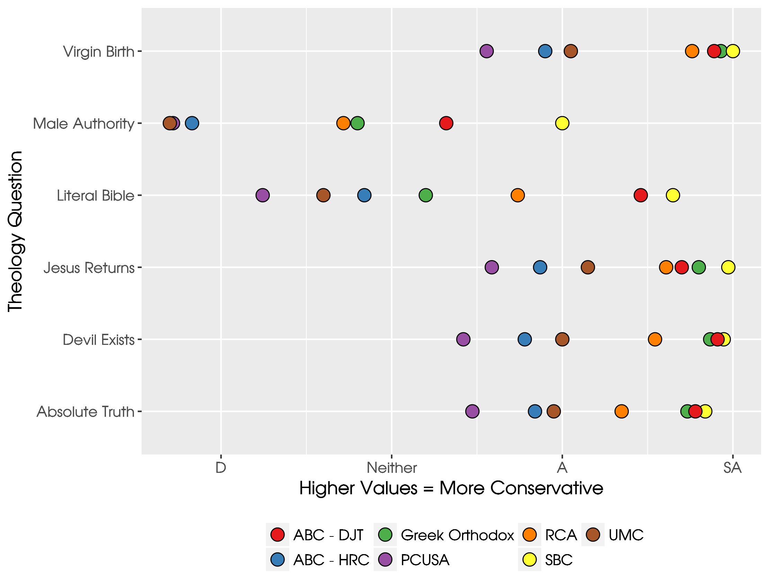
Notes:
The denom is schizophrenic. It’s SBC on one hand. It’s UMC on the other. How to hold this together?

Slide 37
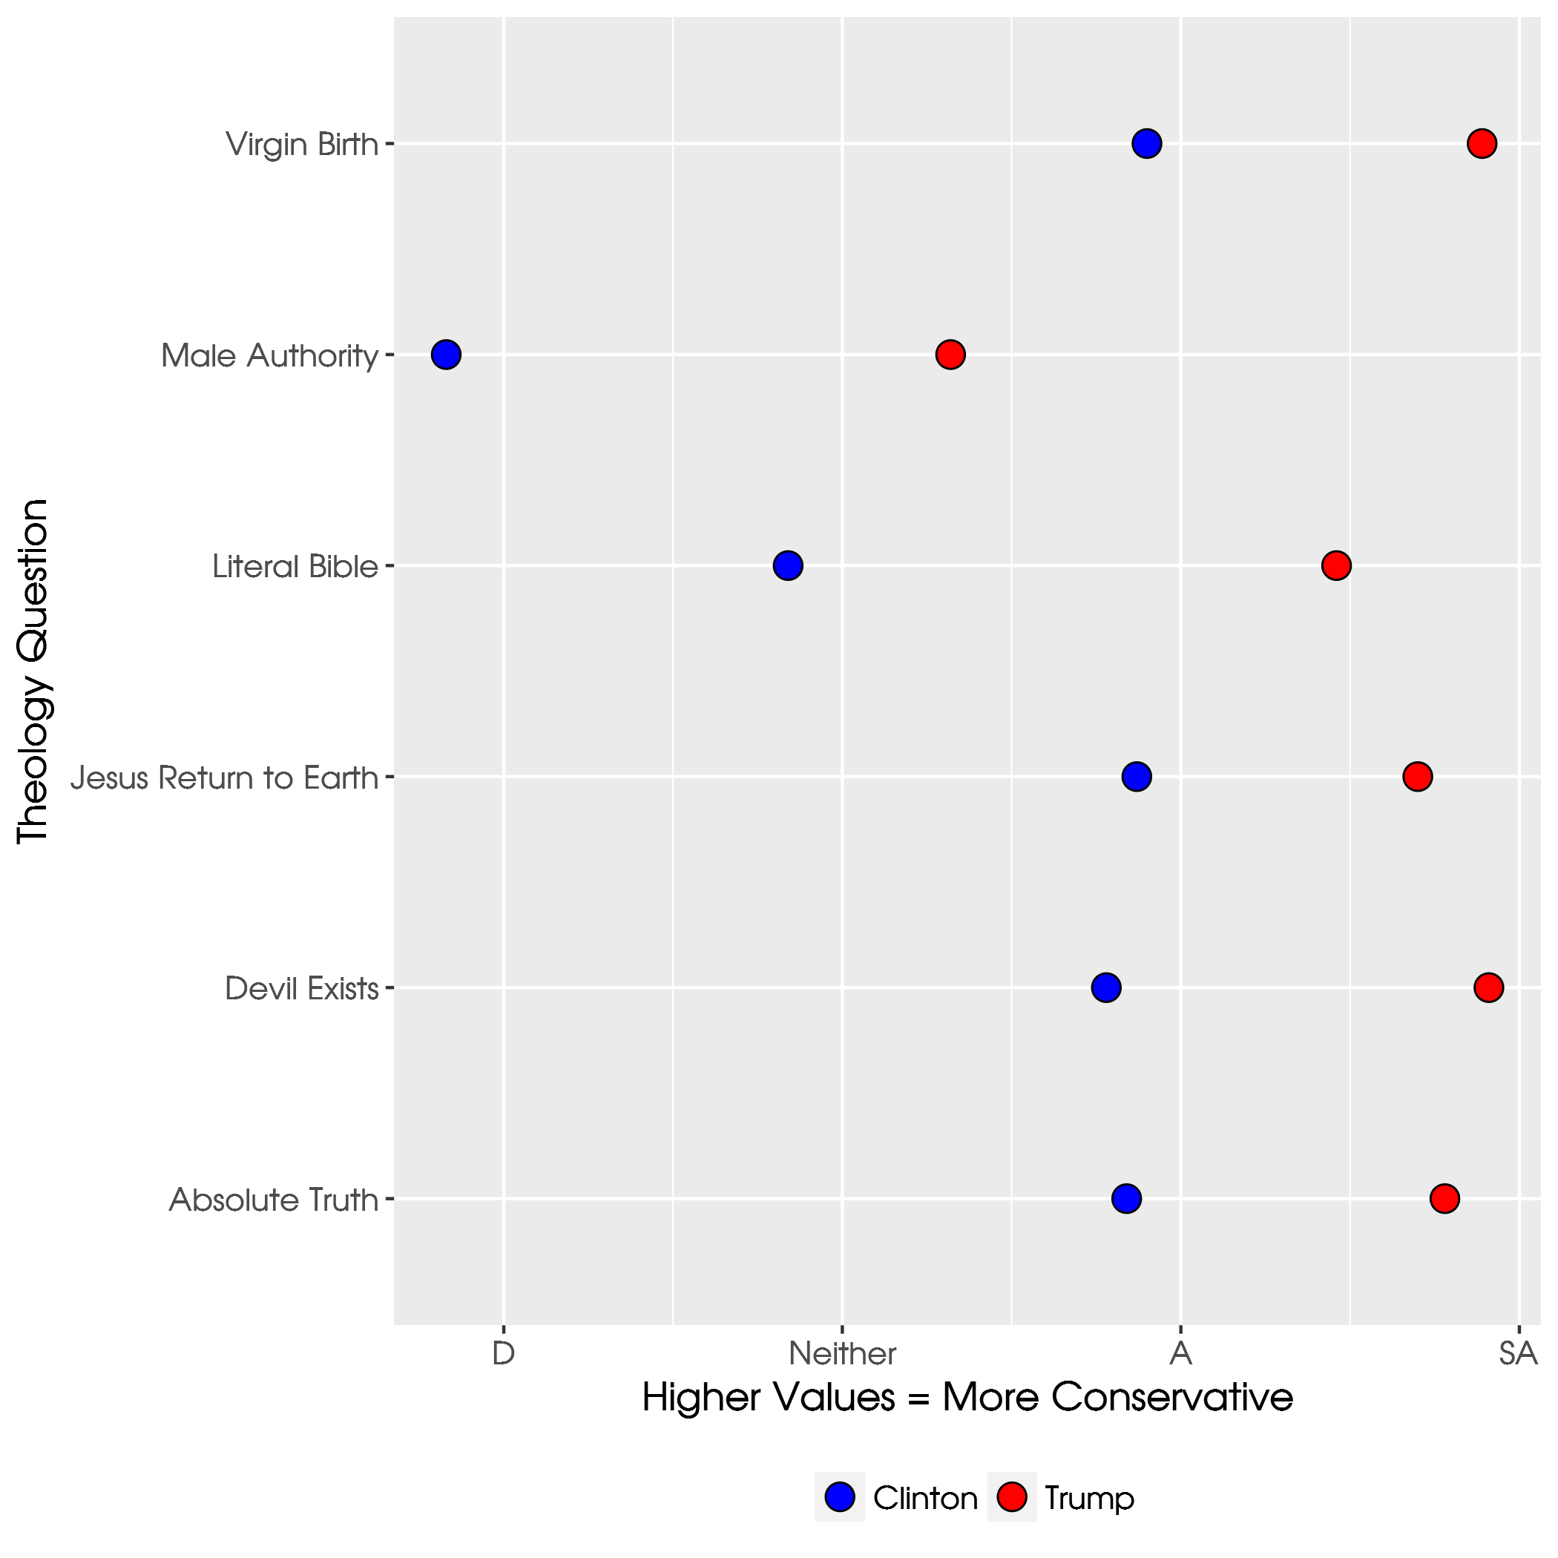

Slide 38
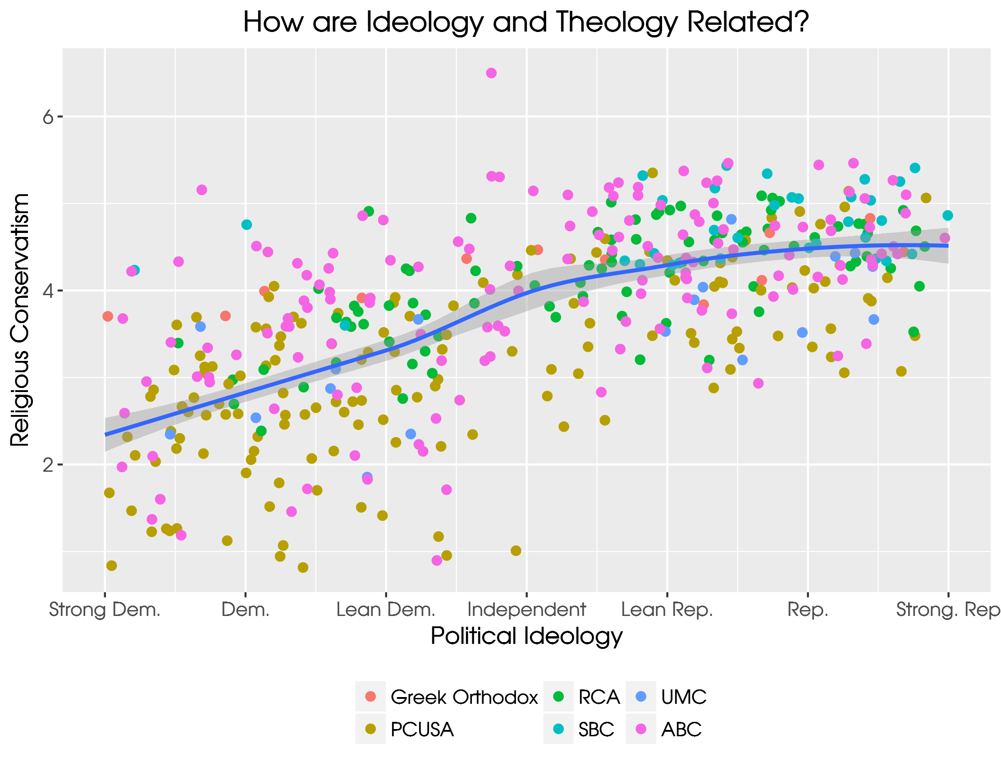
Notes:
Obviously, theology and ideology go hand in hand.

Slide 39
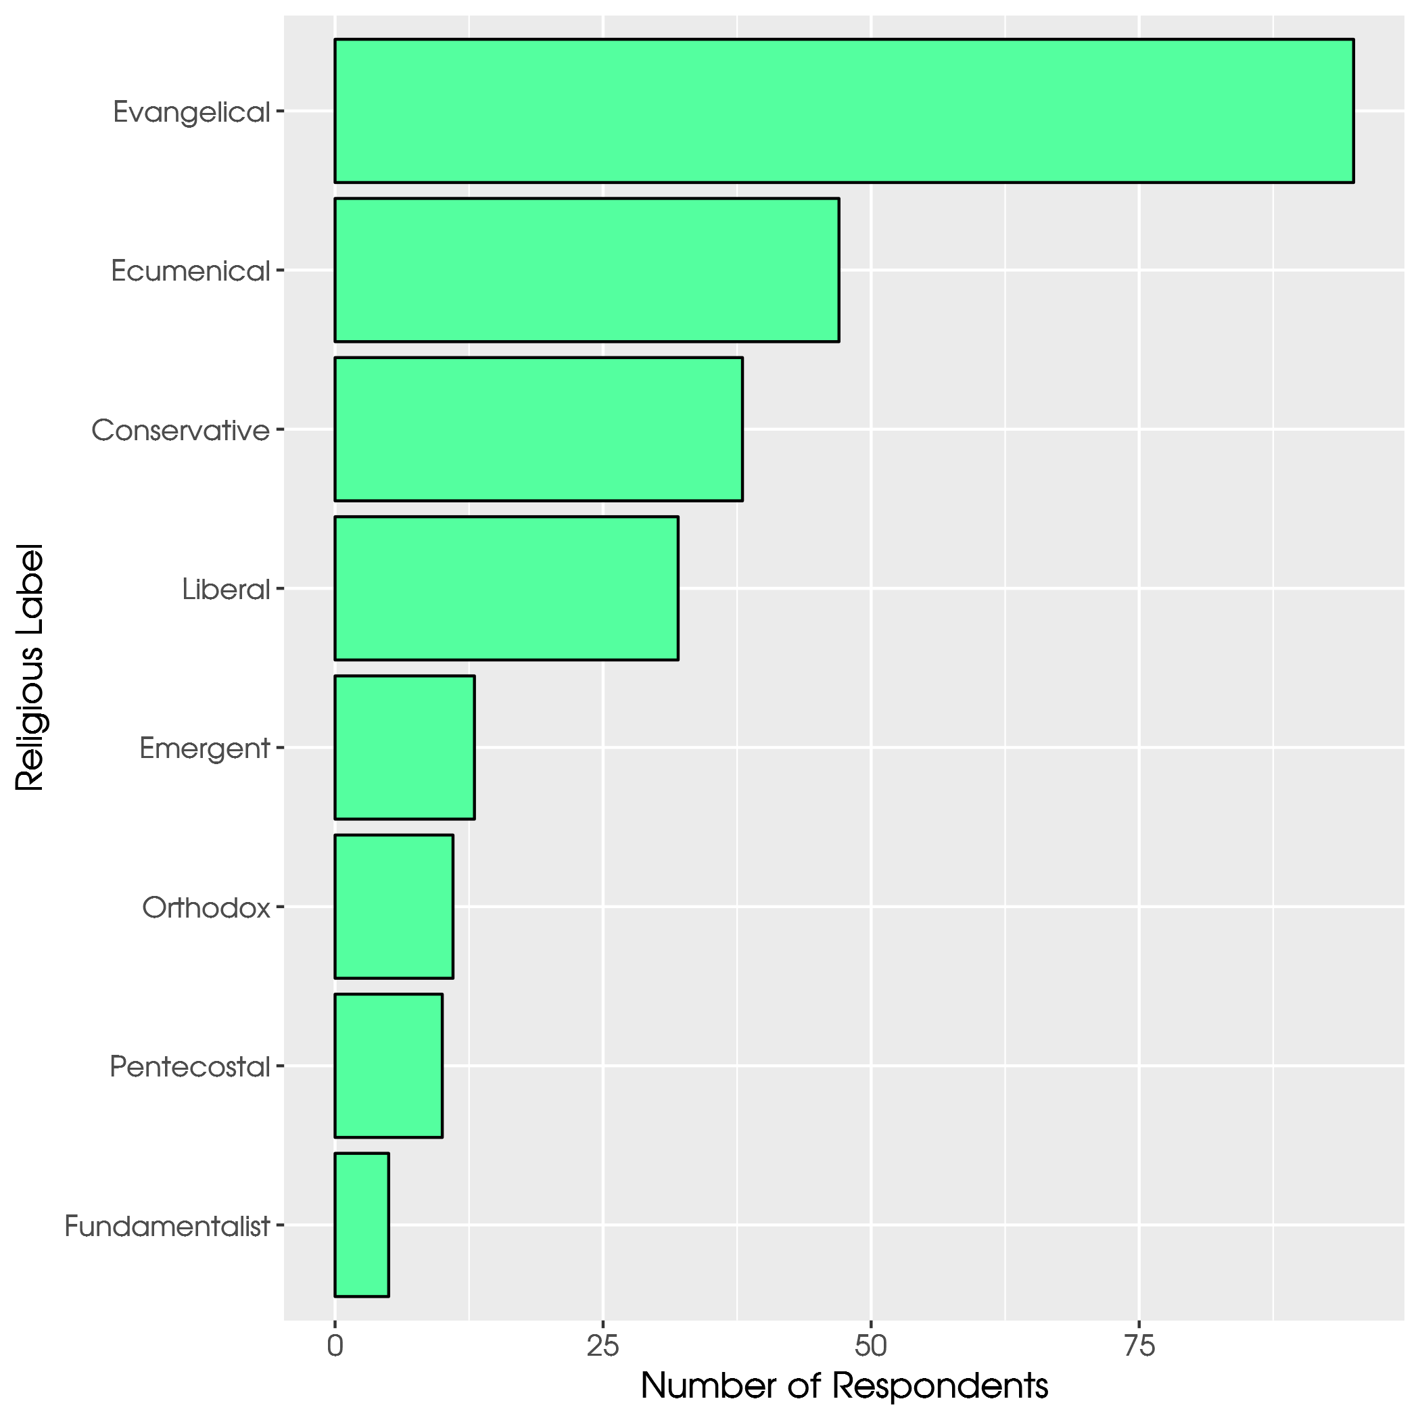
Notes:
Are ABC’s evangelical? Over half clergy respondents say yes. Almost as many conservative as liberal. Not Pentecostal.

Slide 40
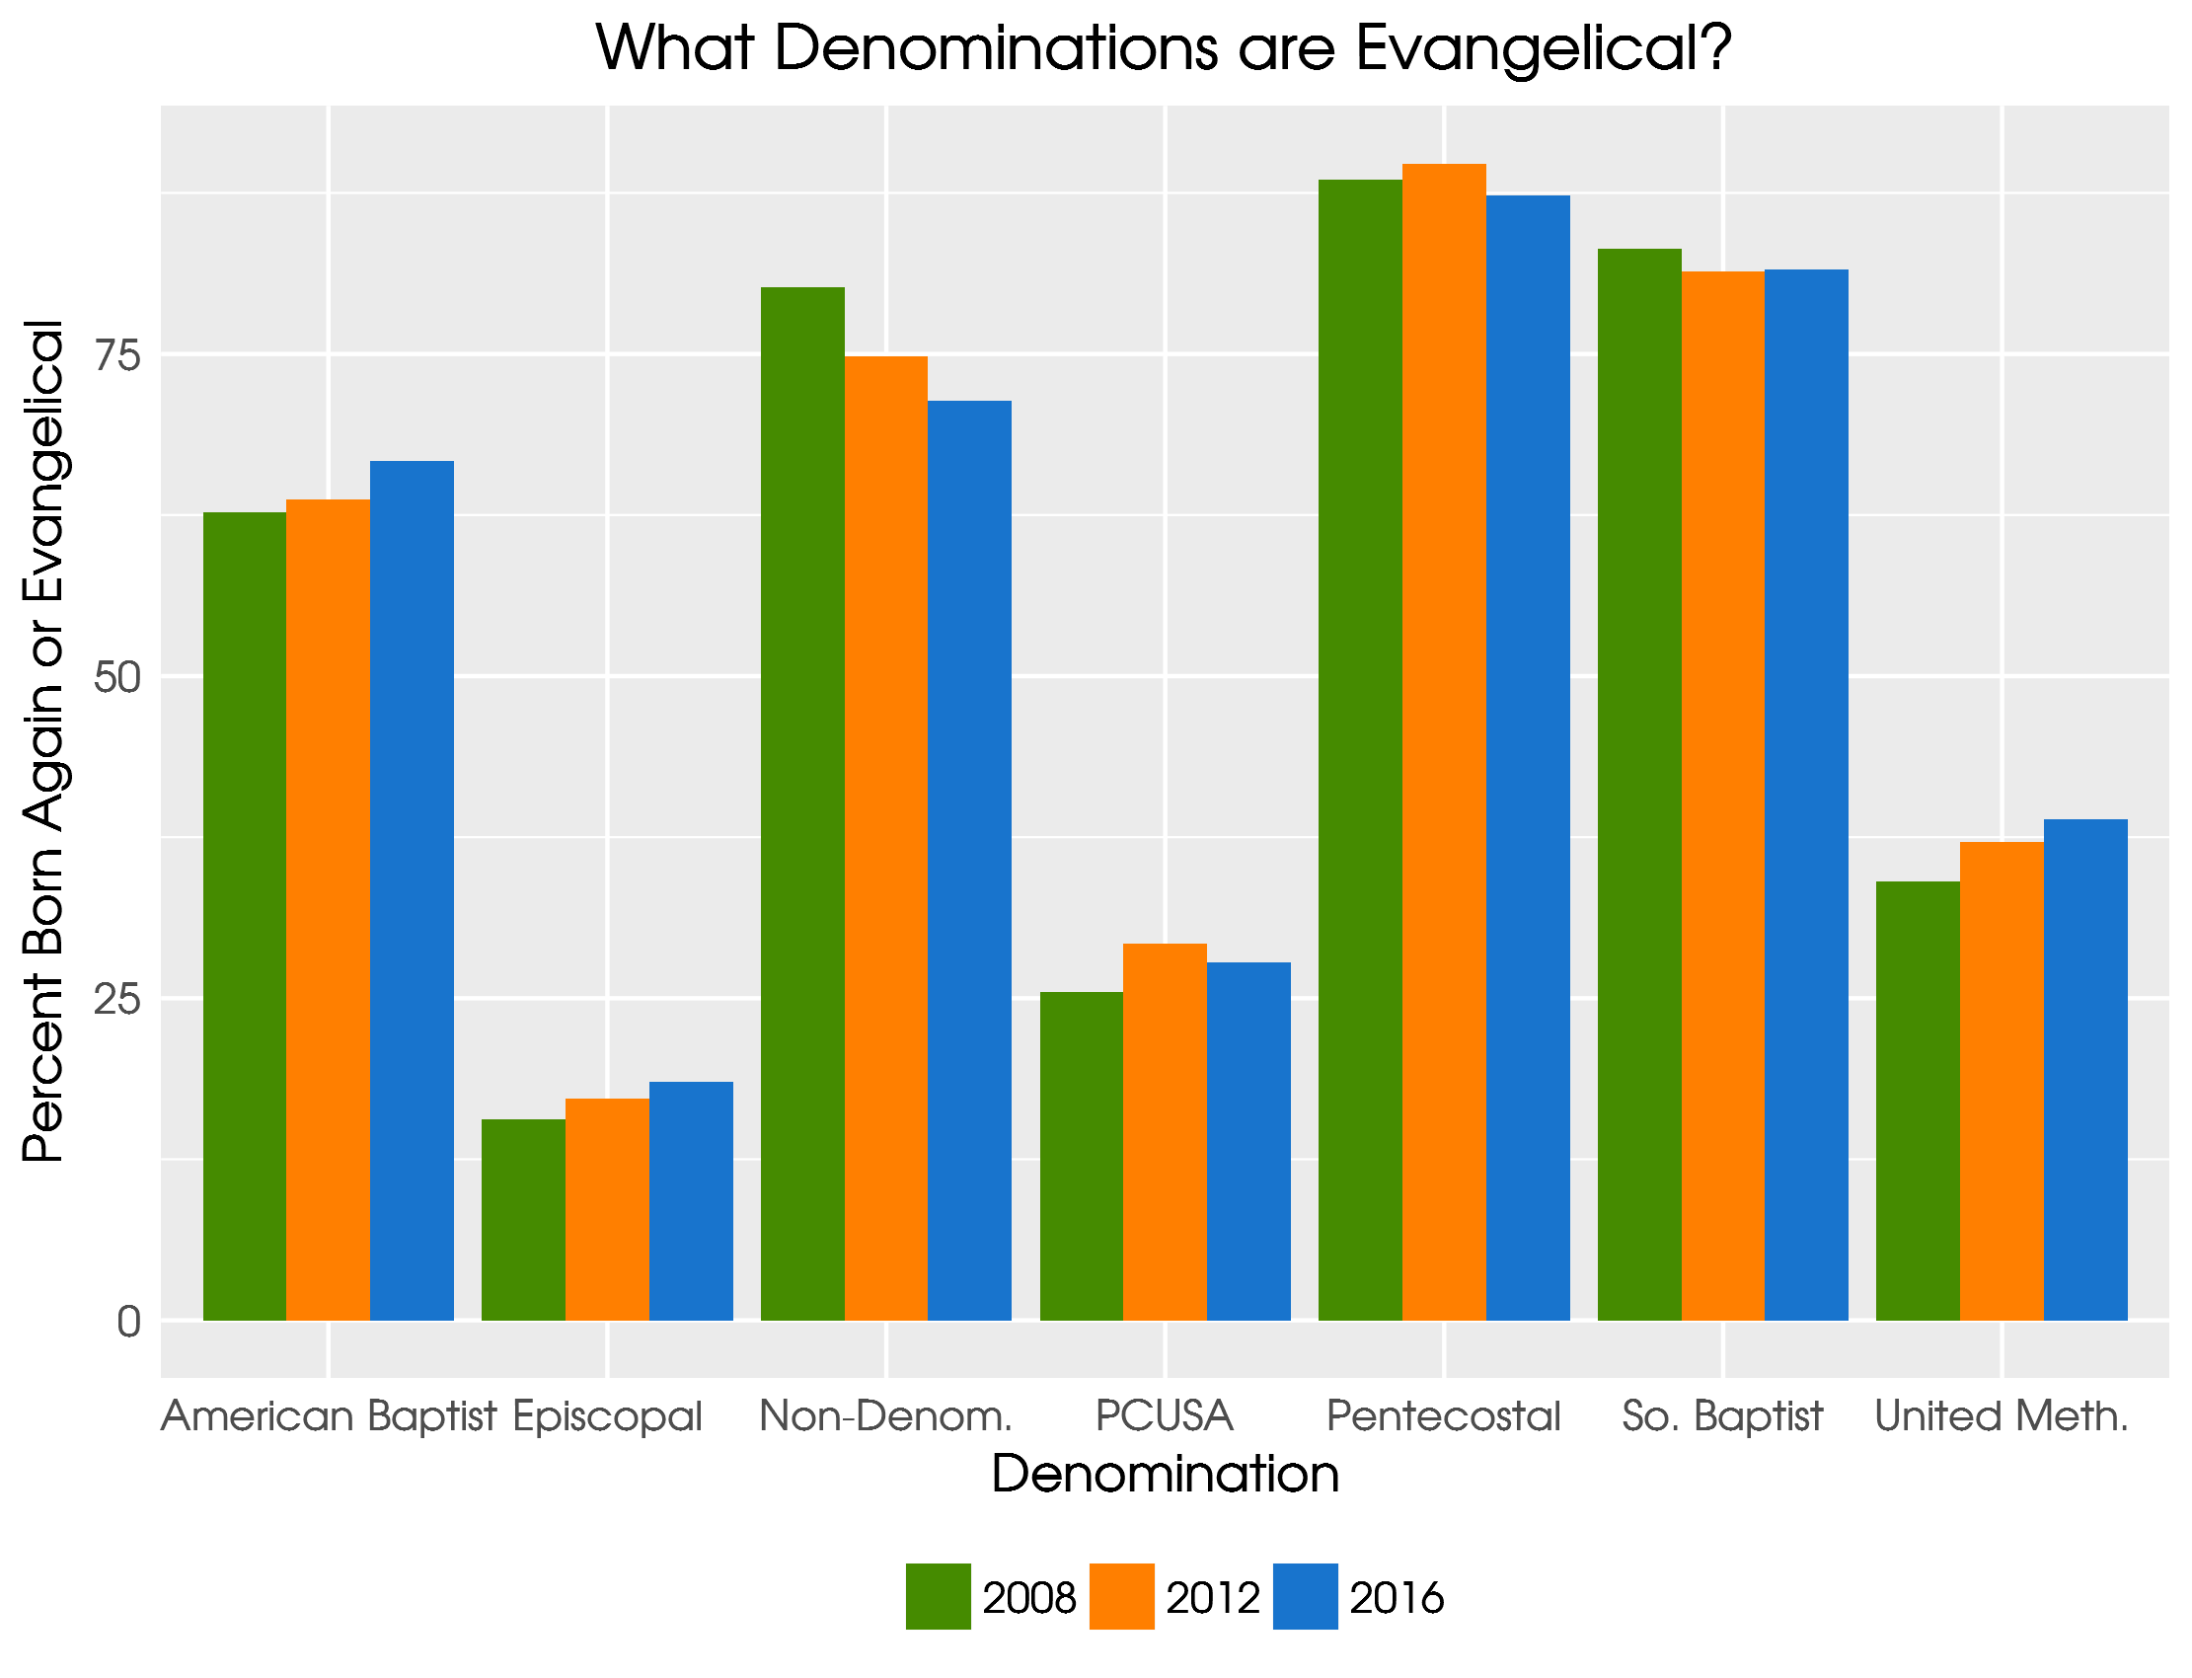
Notes:
ABC becoming more evangelical, so are Episcopal and UMC. Non-denoms are less.

Slide 41
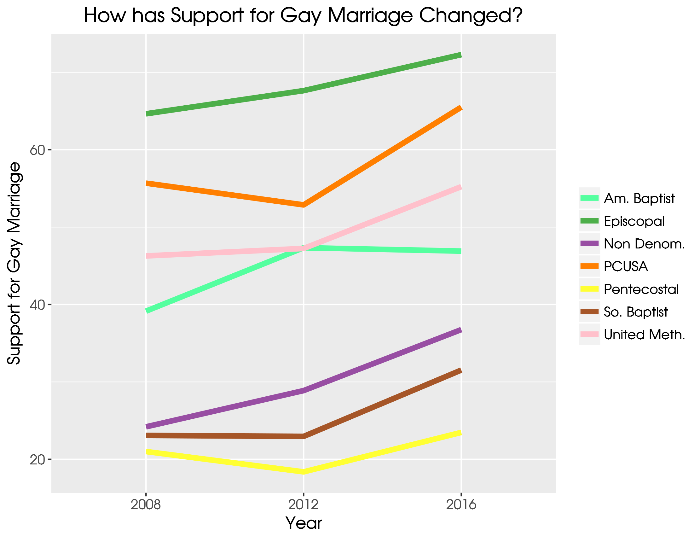
Notes:
ABC has stalled on this.

Slide 42
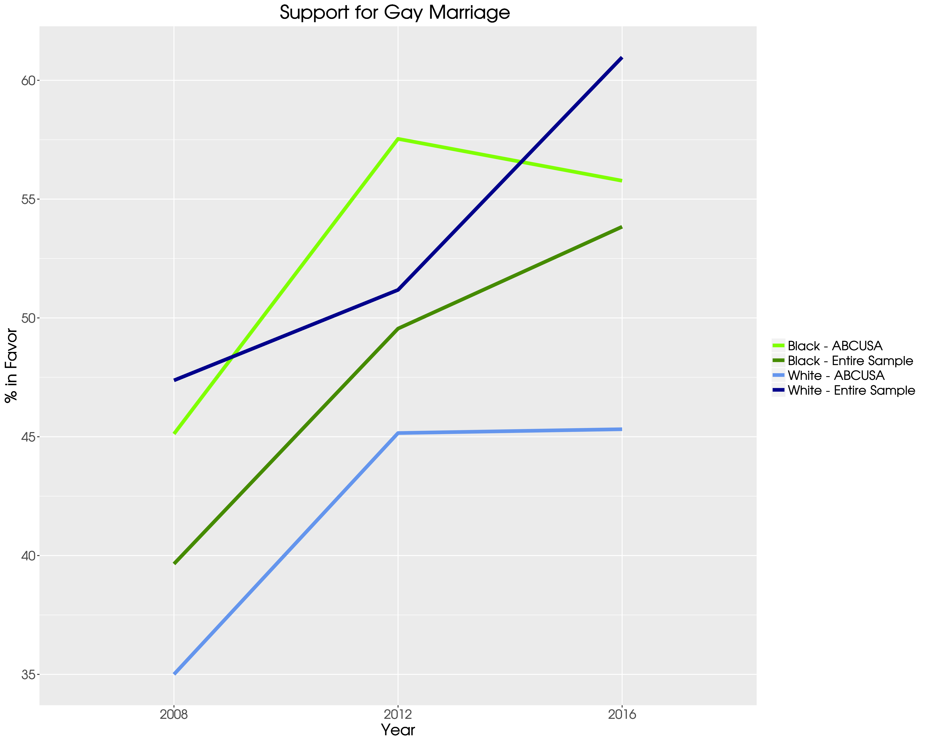
Notes:
ABC has stalled on this.

Slide 43
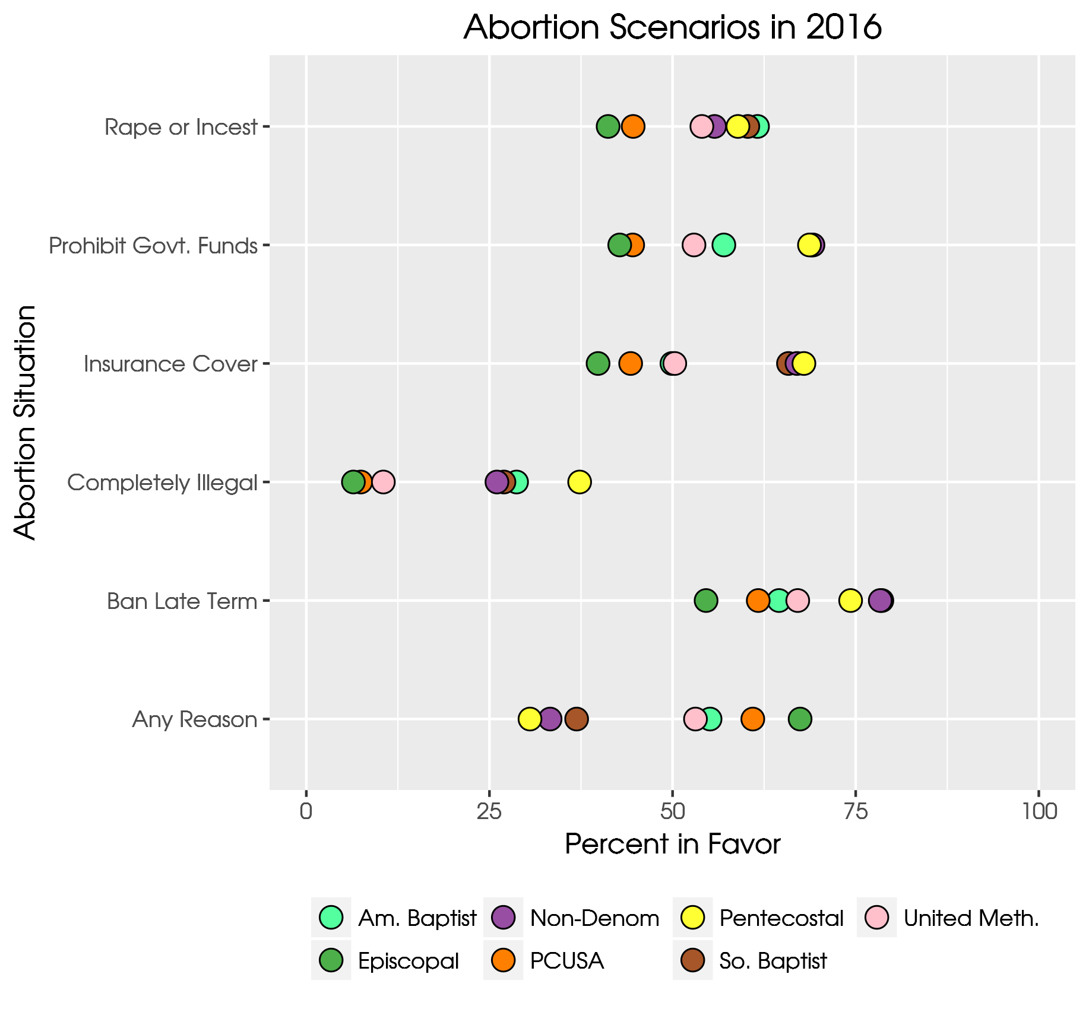
Notes:
ABC are in the middle of the pack.

Slide 44
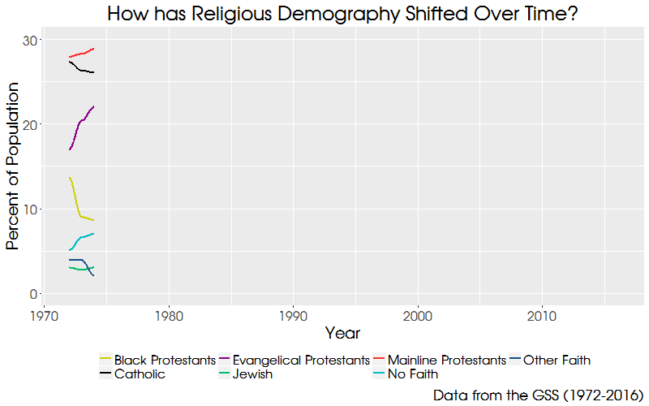

Slide 45
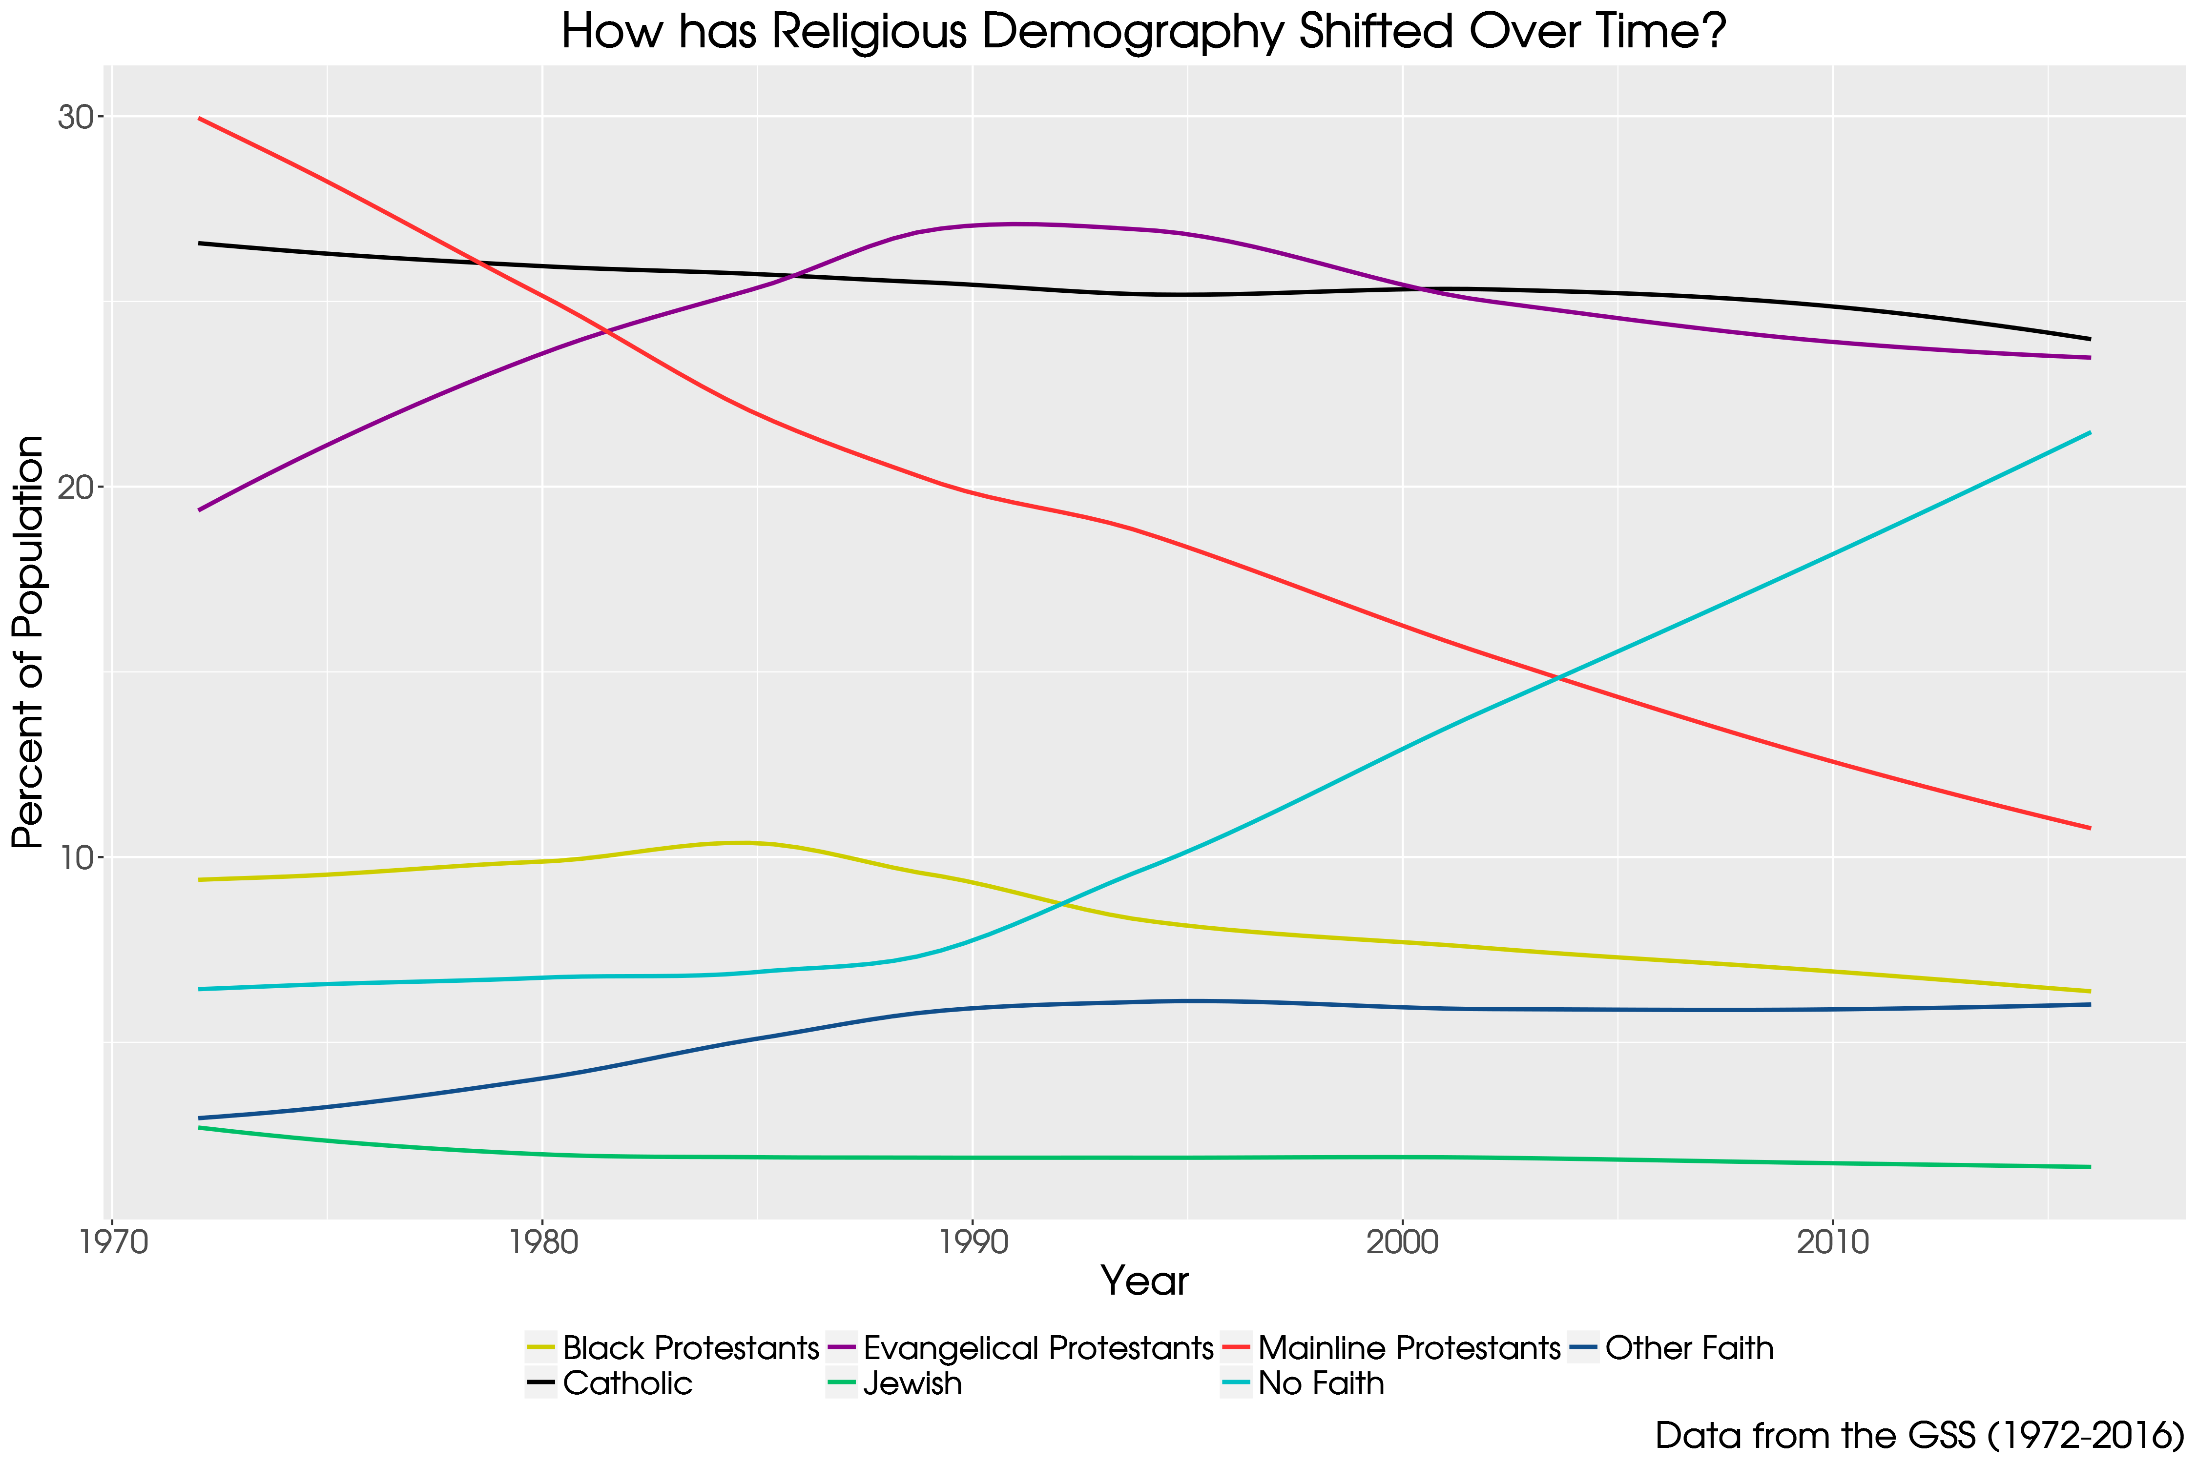

Slide 46
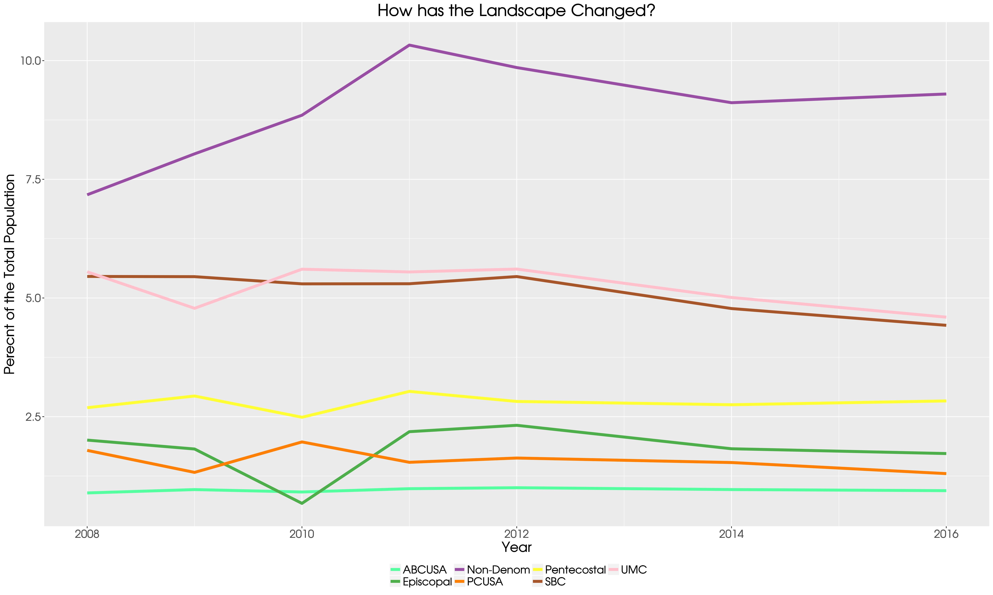

Slide 47
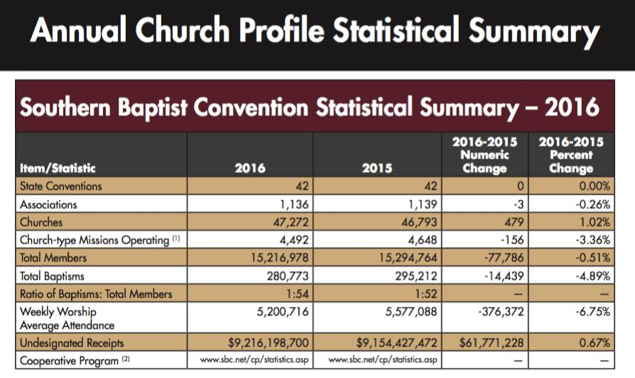

Slide 48
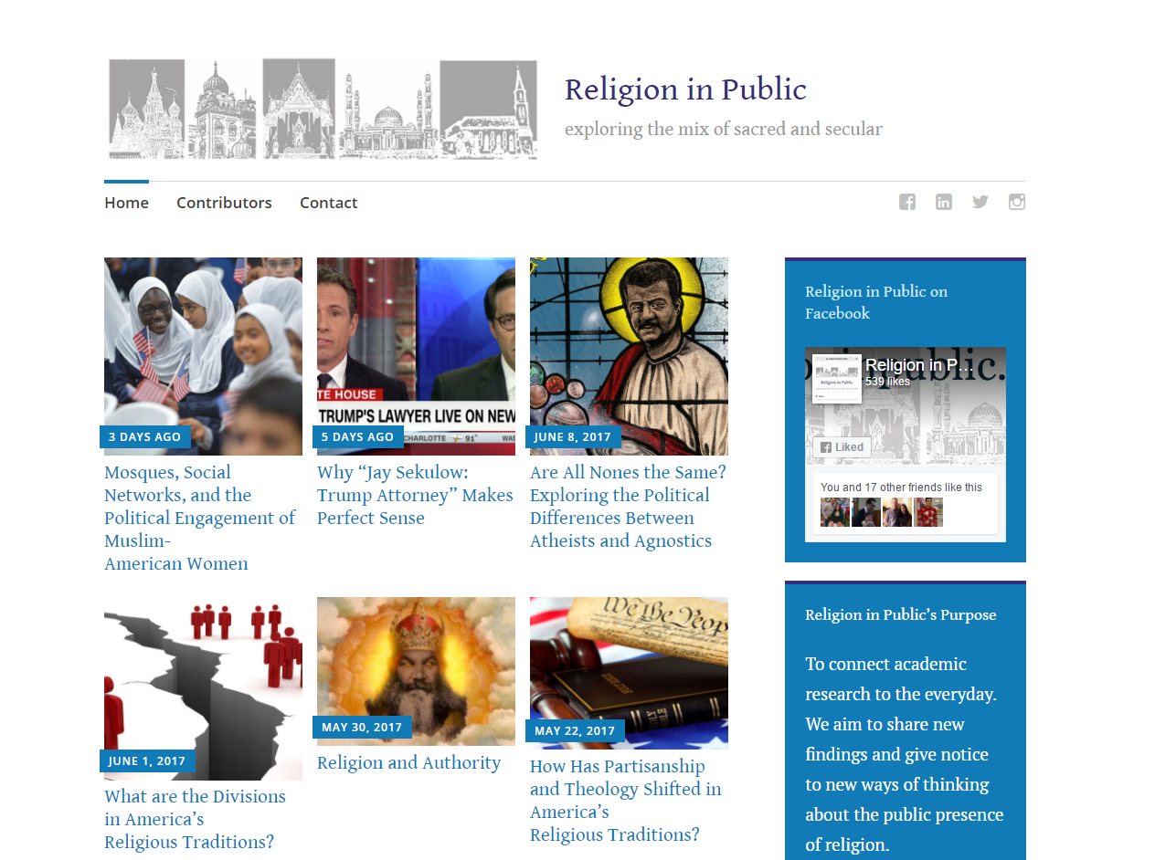
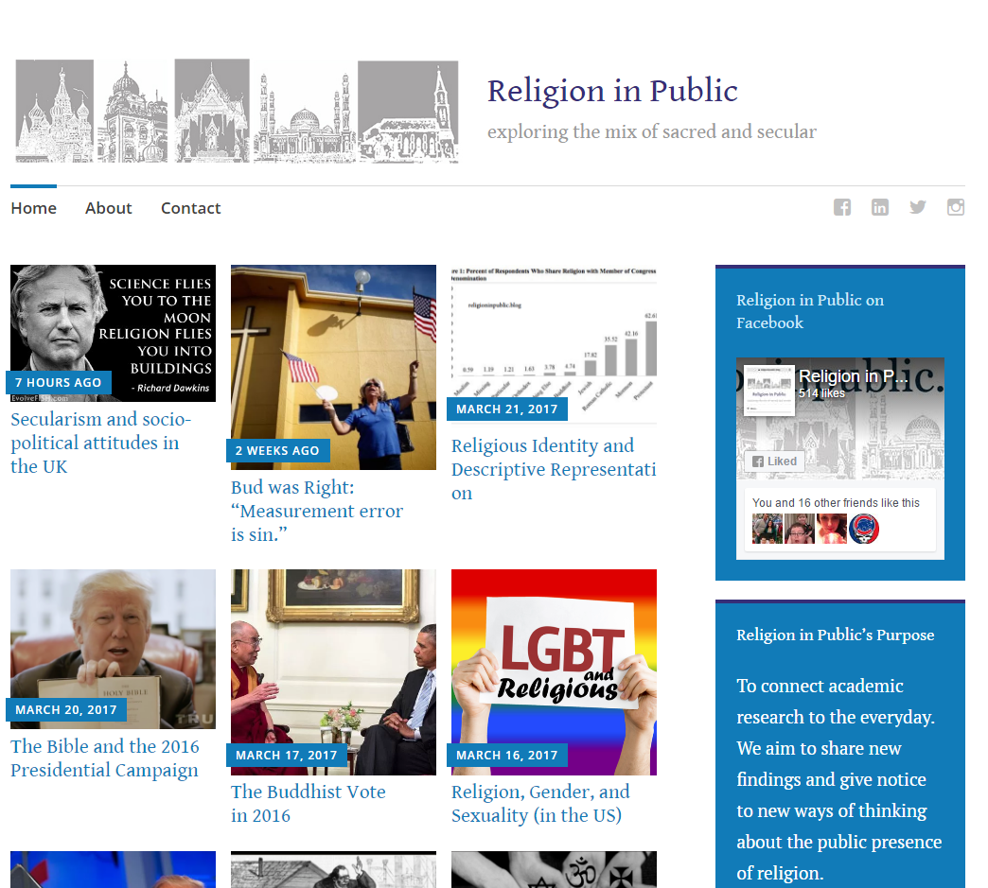
Religion in Public
Contributing authors are social scientists studying religion and politics
religioninpublic.blog
@religion_public
Religion in Public on Facebook

Slide 49
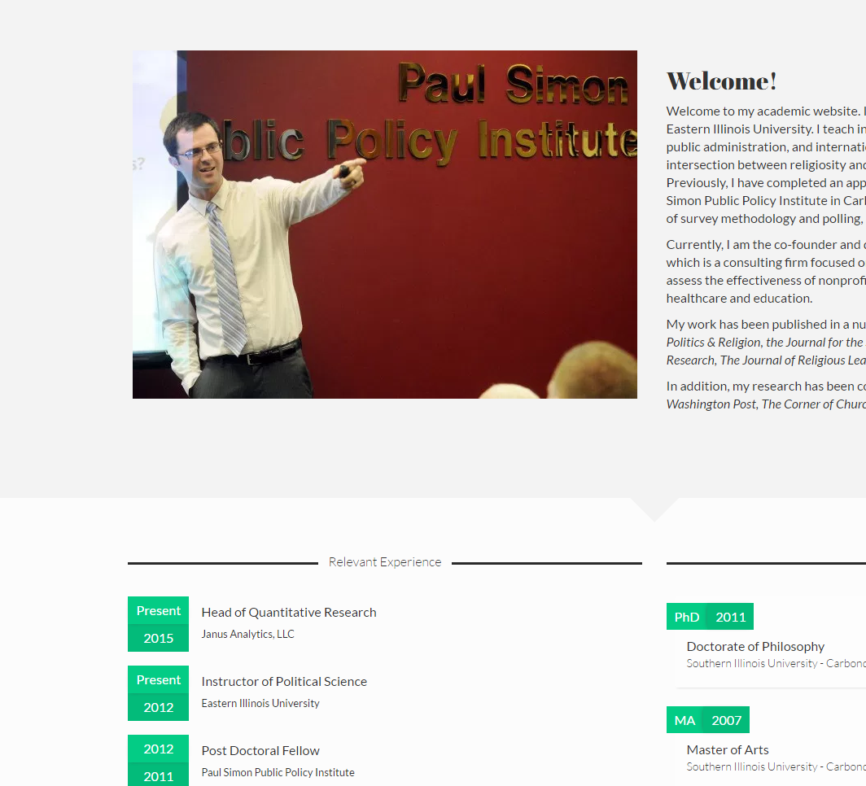
Contact Me
Personal Website: ryanburge.net
Email: ryanburge@gmail.com
Twitter: @ryanburge

